Slide 1
Computer class III
http://10.150.128.11/spss/ http://pubhealthcollo.org/spss/
Download sga.sav – clean
weight2 / (height/100)**2

Slide 2
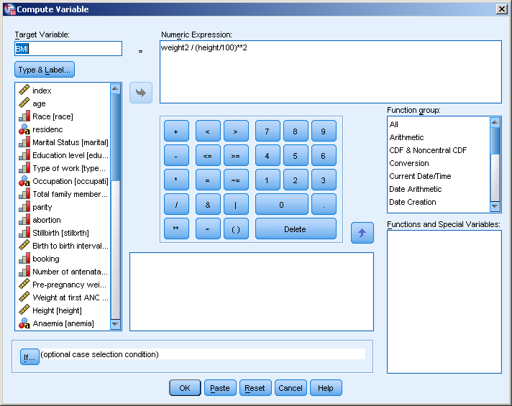

Slide 3
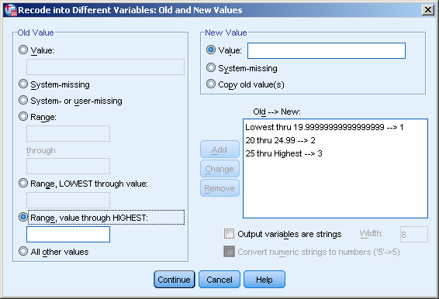

Slide 4
TTest
2 groups, SGA & normal babies. Mean BMI of normal mothers compared against mean BMI of SGA mothers. We expect the babies with normal weight have mothers with good nutrition status. Therefore the mean BMI of SGA mothers should be lower than mean BMI of normal mothers.

Slide 5
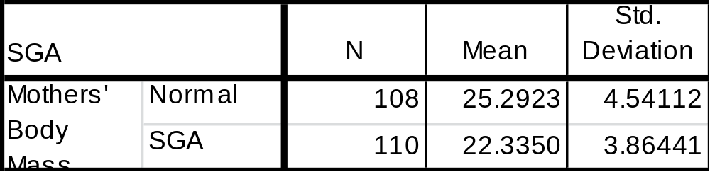
Compare the weight
Normal mothers have higher mean BMI compared to SGA mothers.
Is the difference sig?

Slide 6
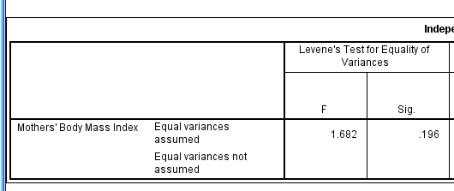
Sig
If p for Levene’s Test > 0.05, assume equal variances.

Slide 7
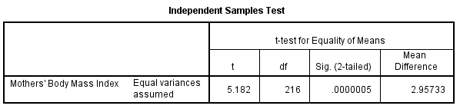
T-test
Mean BMI of SGA mothers (22) was smaller than mean BMI of normal mothers (25).
P value sig, so there is a sig diff of mean. Null hypothesis rejected.
Concl: SGA mothers have a sig lower BMI compared to normal mothers.
Extrapolate – to have healthy babies we should marry girls with good nutritional status.

Slide 8
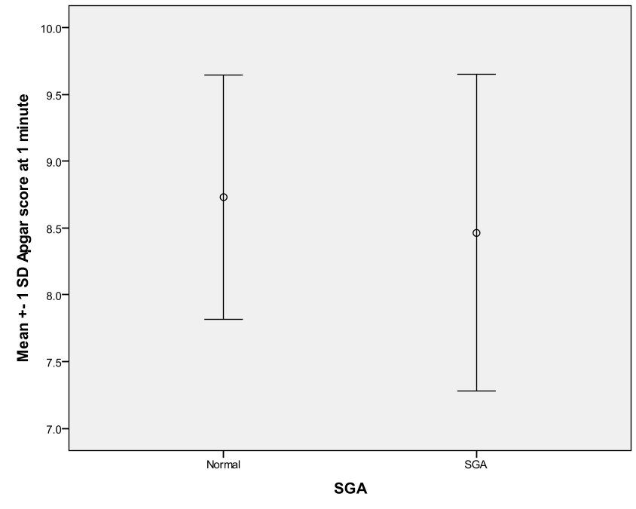
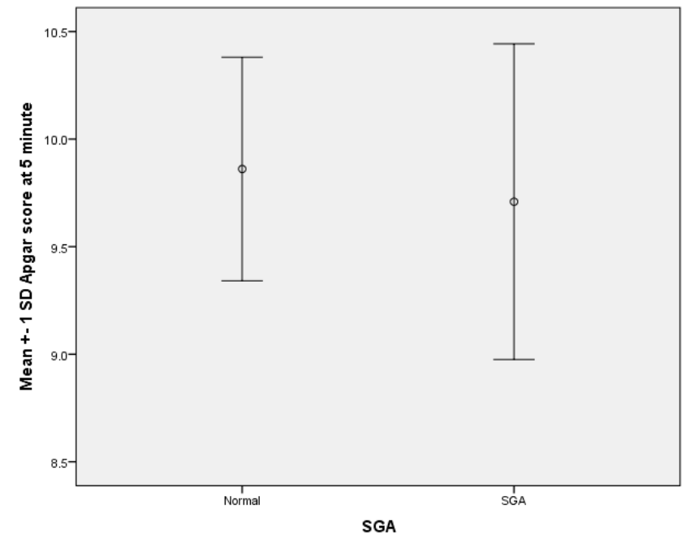
Do yourself
Compare Apgar score at 1 minute and 5 minute between SGA & Normal babies.

Slide 9
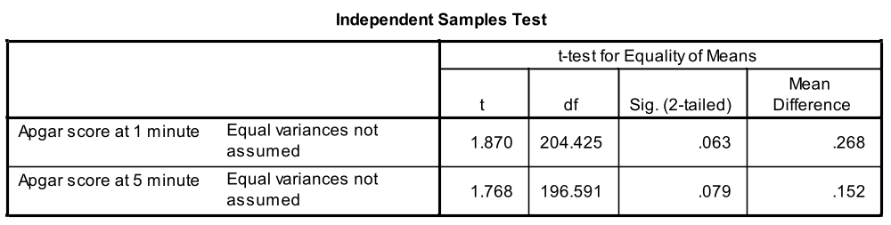

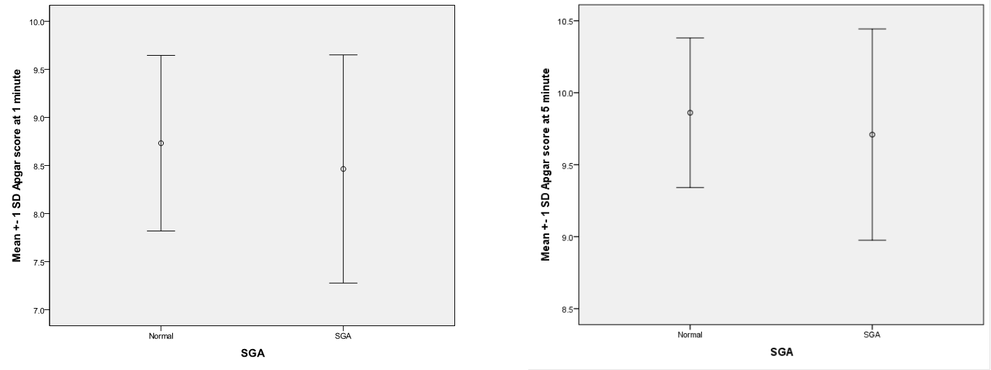
APGAR SCORE

Slide 10
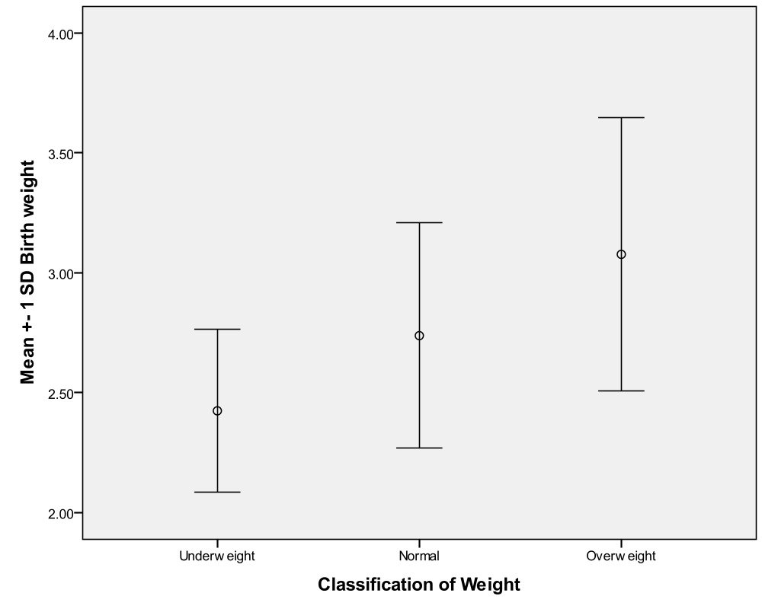
ANOVA
Conduct the appropriate statistical test to find any association between OBESCLAS (Underweight/Normal/Overweight) and BIRTHWGT.

Slide 11

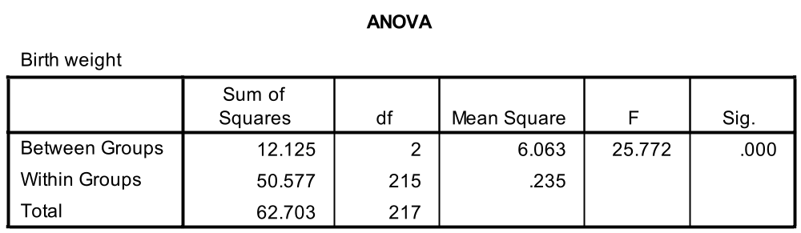
ANOVA
Mean BW
  UW – 2.4
  N – 2.7
  OW -3.0
Diff sig or not?
F very large, p<0.05
Therefore sig diff of mean.

Slide 12
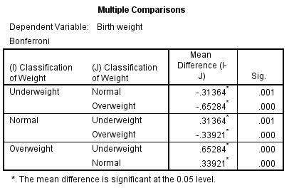
Post Hoc
UW vs Normal – sig
UW vs Overweight – sig
Normal vs overweight - sig

Slide 13
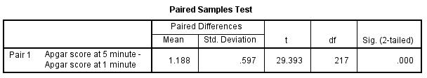
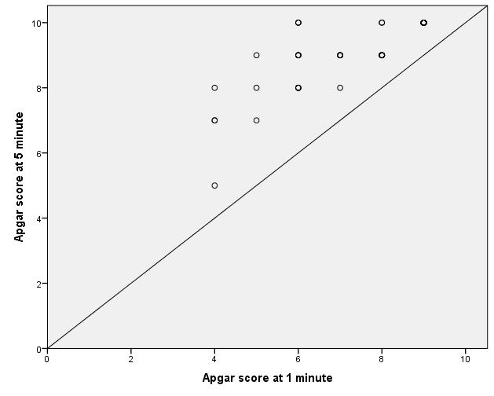
APGAR score 1 vs 5

Slide 14
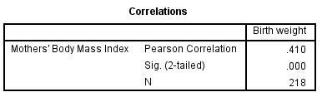
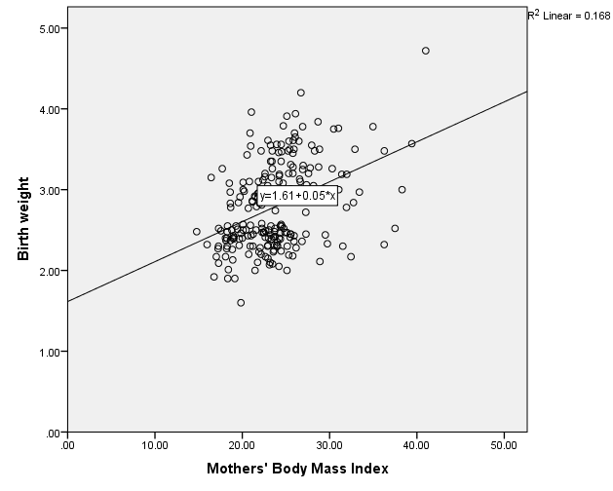
Correlation
BMI & Birth weight
There is a fair and positive correlation between BMI & BW.
The association is sig

Slide 15
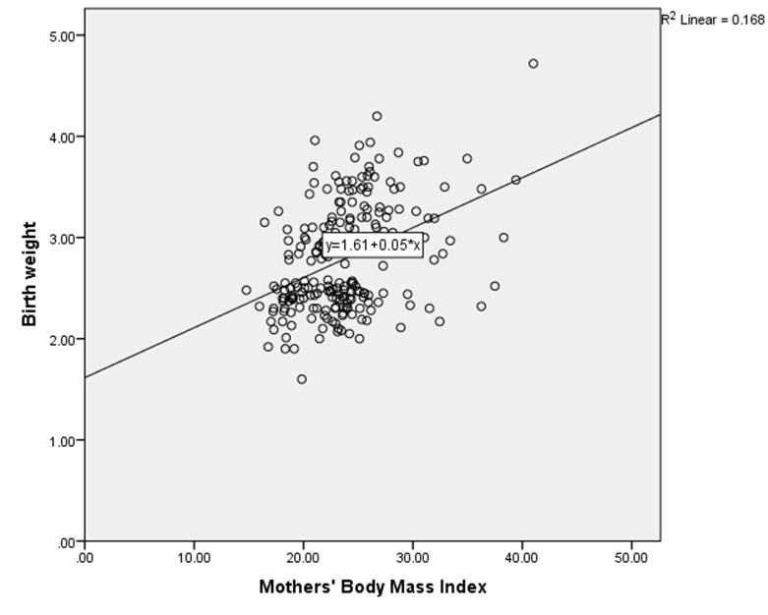
a

Slide 16
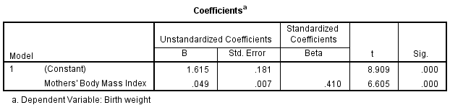
SLR
a
a

