Slide 1
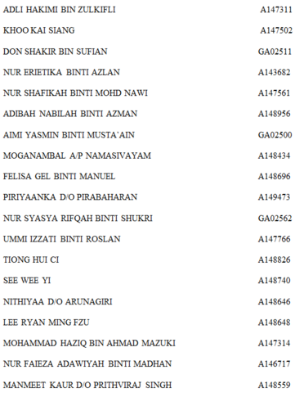
FACTORS AFFECTING POOR ACADEMIC PERFOMANCE AMONG YEAR 2 MEDICAL STUDENTS OF FACULTY OF MEDICINE UKM
LAB 10
MEDICINE AND SOCIETY
FACULTY OF MEDICINE
UNIVERSITI KEBANGSAAN MALAYSIA
PROF. MADYA DR AZMI BIN MOHD TAMIL
FACILITATOR : DR SUJITH KUMAR

Slide 2
INTRODUCTION
Based on our scope of study, the year 2 medical students in UKM are graded by their CGPA as a representation of their academic performance.
Students have many key underlying factors that can influence their academic performance. For example, their gender, ethnicity, breakfast frequency and so on.
So the purpose of this study is to establish the main factors that contribute to a medical students’ academic performance.

Slide 3
LITERATURE REVIEW
ETHNICITY
“Some evidence indicates that in the United Kingdom, as well as in the United States, students from ethnic minority group are more likely to fail a medical examination than are white students.”
Source: Eamonn Ferguson,David James,Laura Madeley, Factors associated with success in medical school: systematic review of the literature,2002, Volume 324 952-9579
GENDER
“According to Borde (1998), found no evidence of academic performance being influenced by gender.”
Source: Victor Mlambo, An analysis of some factors affecting student academic performance in an introductory biochemistry course at the University of the West Indies, 2011, Vol. 1, No. 2, November 2011, 79–92
STUDY HABITS
“From the research assessing different study habits, it was found that 114 (62.98%) of the students with high GPAs were ensuring silence and no interruptions during studying (P=0.013) as compared to 89 (50%) of the lower GPA group. In addition, 40.3% of students with high GPAs seemed to favour a certain posture or body position, such a sitting or lying on the floor. However, students with a low GPA were less likely (29.7%) to commit to a certain comfortable position (P=0.036).”
Source: Credé M, Kuncel NR. Study habits, skills, and attitudes: the third pillar supporting collegiate academic performance. Perspect Psychol Sci. 2008;3(6):425–453.

Slide 4
TIME SPENT FOR EXTRACURRICULAR ACTIVITIES
“According to this research medical students need to have time management plan to speed up their studies. Spending more than 7 hours on extracurricular activities have shown to cause accumulation of assignment and revision.”
Source:HAMZA M. ABDULGHANI, ABDULMAJEED A. AL-DREES, MAHMOOD S. KHALIL, FARAH AHMAD, GOMINDA G. PONNAMPERUMA & ZUBAIR AMIN,What factors determine academic achievement in high achieving undergraduate medical students? ,2014, 36: S43–S48)
TIME SPENT FOR FAMILY ACTIVITIES
“Many extracurricular activities have proven to be beneficial in building and strengthening academic achievement, even if the activities are not obviously related to academic subjects like for example family events.”
Source: Ali, Norhidayah, et al. "THE FACTORS INFLUENCING STUDENTS’PERFORMANCE AT UNIVERSITI TEKNOLOGI MARA KEDAH, MALAYSIA." Management Science and Engineering 3.4 (2009): P81-90

Slide 5
FREQUENCY OF VISIT TO DOCTORS
“Research have shown that 89% ( 89 students out of 100 sample) significantly has less visits to doctors perform much better than the 21% (21 students out of 100 sample) who has frequent records of doctor visit.”
Source: Jean-Louis G, Von Gizycky H, Zizi F & Nunes J, Factors Affecting Academic Performance Of Undergraduate Students At Christian University,1998.
FREQUENCY OF TAKING BREAKFAST
“Eating breakfast appears to predict high GPAs.”
Source:DeBerard, M. Scott, Glen I. Spielmans, and Deana C. Julke 2012. "Predictors Of Academic Achievement And Retention Amongcollege Freshmen: A Longitudinal Study." College Student Journal 38.1 (2004): 66-80.
LECTURER RELATED FACTOR
“The guidance from the teacher also affects the student performance. The guidance from the parents and the teachers indirectly affect the performance of the students.”
Source: Irfan Mushtaq & Shabana Nawaz Khan, Factors Affecting Students’ Academic Performance, 2006 , Volume 12 Issue 9 Version 1.0

Slide 6
PROBLEM FRAMEWORK
Factors affecting academic performance
Gender
Lecturer-related factors
Extra-curricular activities
Frequency of taking breakfast
Study habits
Ethnicity
Time spent for family events
Frequency of visit doctors

Slide 7
GENERAL OBJECTIVES
To determine the important factors associated with poor academic performance among the Year 2 UKM medical students 2015/2016.

Slide 8
SPECIFIC OBJECTIVES
To establish the relationship between gender and academic performance of students.
To establish the relationship between ethnicity and academic performance of students.
To establish the relationship between study habits and academic performance of students.
To establish the relationship between time spent for extracurricular activities and academic performance of students.
To establish the relationship between time spent for family activity and academic performance of students.
To establish the relationship between frequency of visit to doctors and academic performance of students.
To establish the relationship between frequency of taking breakfast per week and academic performance of students.
To establish the relationship between lecturer-related factors and academic performance of students.

Slide 9
Hypothesis
Females present with poor academic performances as compared to males.
Ethnic majority group shows poorer academic performance.
Poor study habit causes poor academic performance among students.
Spending more time for extracurricular activities causes poor academic among students.
Spending more time for family activities causes poor academic among students.
High frequency of visit to doctors (Poor health condition) causes poor academic performance among students.
Low frequency of taking breakfast causes poor academic performance among students.
Poor lecturer’s skills cause poor academic performance of students.

Slide 10
METHODOLOGY
A) CROSS SECTIONAL STUDY
Measures the relationship between factors affecting academic performance in a particular time.
Factors affecting academic performance |  | Academic Performance
Gender | Male | Good / Poor
 | Female | Good / Poor
Ethnicity | Bumiputera | Good / Poor
 | Indian | Good / Poor
 | Chinese | Good / Poor
Study habits |  | Good / Poor
Time spent for extracurricular activities |  | Good / Poor
Time spent for family activity |  | Good / Poor
Frequency of visit to doctors |  | Good / Poor
Frequency of taking breakfast |  | Good / Poor
Lecturer-related factors |  | Good / Poor
B) STUDY FIELD
Preclinical building of UKM’s Medical Faculty, Cheras, Kuala Lumpur

Slide 11
C) CONVENIENT SAMPLING
154 of second year undergraduate students of Medical Faculty in Universiti Kebangsaan Malaysia (UKM), Cheras campus, starting from 5th October 2015 (Excludes members from Lab 10 and students who did not complete the questionnaires)
D) QUESTIONNAIRE
Self administered
Adopted from Balbalosa, J.,F., 2010: Factors affecting performance of laboratory high school students at Laguna state polytechnic university academic year 2009-2010.
Principe, H., R., 2005: Factors influencing students’ academic performance in the first accounting course: a comparative study between public and private universities in Puerto Rico.
E) STUDY MEASUREMENT
Cumulative Grade Points Average (CGPA)
F) OPERATIONAL DEFINITIONS
1) Academic performance: Poor academic performance : CGPA 2.99 and below
2) Gender: Male & Female
3) Ethnicity: Bumiputera & Indian & Chinese
4) Study habits
Poor : score less than 51
Average : score from 51 to 60
Good : score more than 60

Slide 12
5) Time spent for extracurricular activities
Low : score less than 5
Low average : score from 5 to 9
High average : score from 10 to 14
High : score more than 14
6) Time spent for family activity
Low : score less than 5
Low average : score from 5 to 9
High average : score from 10 to 14
High : score more than 14
7) Frequency of visit to doctors
Frequency of student visiting doctors during last semester.
8) Frequency of taking breakfast
Frequency of student taking breakfast per week.
9) Lecturer related factors
Poor : score less than 31
Average : score from 31 to 40
Good : score more than 40
G) DATA ANALYSIS
Microsoft Excel 2010 and SPSS version 21
H) ANALYTIC STATISTIC
Descriptive statistics
T-test
Chi-Square test
Independent samples Mann Whitney U test
Significant level of p<0.05

Slide 13
QUESTIONNAIRES
Gender
Ethnicity
Study habits
Time spent for extracurricular activities
Time spent for family activity
Frequency of visit to doctors
Frequency of taking breakfast
Lecturer-related factors

Slide 14
RESULT : DESCRIPTIVE ANALYSIS
44.2%
55.8%

Slide 15
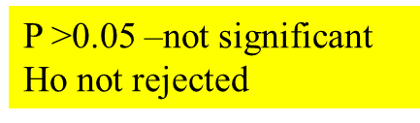
Null hypothesis: There is no significant association between gender and academic performance of students.
RESULT: ANALYTIC ANALYSIS
Chi-square test
Factor |  |  | N | X² | P
 | Poor | Good
Gender
Female | 60(58.3%) | 43(41.7%) | 103
Male | 26(51.0%) | 25(49.0%) | 51
CGPA
0.732
0.392
CONCLUSION: THERE IS NO SIGNIFICANT ASSOCIATION BETWEEN GENDER AND ACADEMIC PERFORMANCE.

Slide 16

Null hypothesis: There is no significant association between ethnicity and academic performance of students .
Factor
 | Poor | Good
Ethnicity
Chinese | 7 (21.9%) | 25 (78.1%) | 32 (100%)
Indian | 11 (61.1%) | 7 (38.9%) | 18 (100%)
Bumiputera | 65 (62.5%) | 39 (37.5%) | 104 (100%)
Chi-square test
CGPA
N
X²
P
16.680
<0.0005
THERE IS SIGNIFICANT ASSOCIATION BETWEEN ETHNICITY AND ACADEMIC PERFORMANCE.
CONCLUSION: BUMIPUTERA SHOWS POORER ACADEMIC PERFORMANCE.

Slide 17
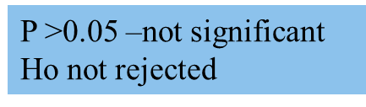
Null hypothesis: There is no significant association between study habits and academic performance of students.
Chi-square test
Factor
 | Poor | Good
Study Habits
<51 Poor | 26 (60.5%) | 17 (39.5%) | 43 (100%)
51-60 Average | 32 (47.1%) | 36 (52.9%) | 68 (100%)
>60 Good | 25 (58.1%) | 18 (41.9%) | 43 (100%)
Academic performance
N
X²
P
2.338
0.311
CONCLUSION: THERE IS NO SIGNIFICANT ASSOCIATION BETWEEN STUDY HABITS AND ACADEMIC PERFORMANCE.

Slide 18




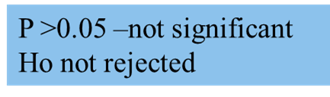
Null hypothesis: There is no significant association between time spent for extracurricular activities and academic performance of students.
Chi-square test
Factors
 | Poor | Good
<5 | 26 (59.1%) | 18 (40.9) | 44 (100%)
5-9 | 35 (60.3%) | 23 (39.7) | 58 (100%)
10-14 | 10 (40.0%) | 15 (60.0) | 25 (100%)
>14 | 15 (55.6%) | 12 (44.4) | 27 (100%)
Time Spent for Extracurricular Activities
3.211
0.360
CONCLUSION: THERE IS NO SIGNIFICANT ASSOCIATION BETWEEN TIME SPENT FOR EXTRACURRICULAR ACTIVITIES AND ACADEMIC PERFORMANCE.

Slide 19


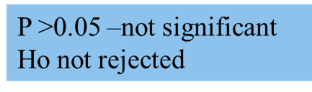
Null hypothesis: There is no significant association between time spent for family activity and academic performance of students.
Factor
 | Poor | Good
<5 | 42 (56.8%) | 32 (43.2%) | 74 (100%)
5-9 | 24 (52.2%) | 22 (47.8%) | 46 (100%)
10-14 | 12 (66.7%) | 6 (33.3%) | 18 (100%)
>14 | 8 (50.0%) | 8 (50.0%) | 16 (100%)
Time Spent for Family Activity
1.353
0.717
CONCLUSION: THERE IS NO SIGNIFICANT ASSOCIATION BETWEEN TIME SPENT FOR FAMILY ACTIVITY AND ACADEMIC PERFORMANCE.

Slide 20
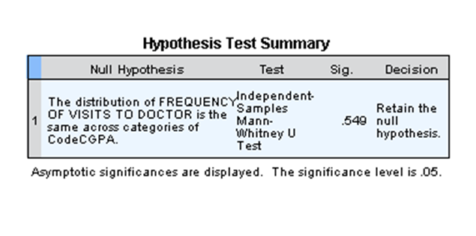
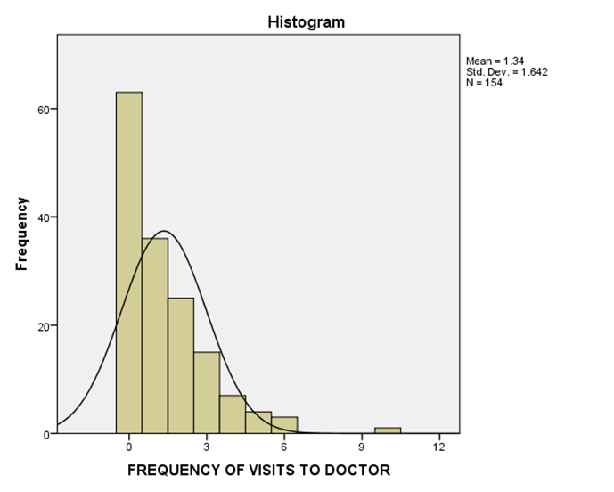

Null hypothesis: There is no significant association between frequency of visit to doctor and academic performance of students.
Non-parameter test – Mann Whitney U Test
CONCLUSION: THERE IS NO SIGNIFICANT ASSOCIATION BETWEEN FREQUENCY OF VISIT TO DOCTOR AND ACADEMIC PERFORMANCE.
Mean= 1.34, median=1.00,mode=0
Standard Deviation=1.642
Skewness: 1.791, kurtosis: 4.794
N=154

Slide 21
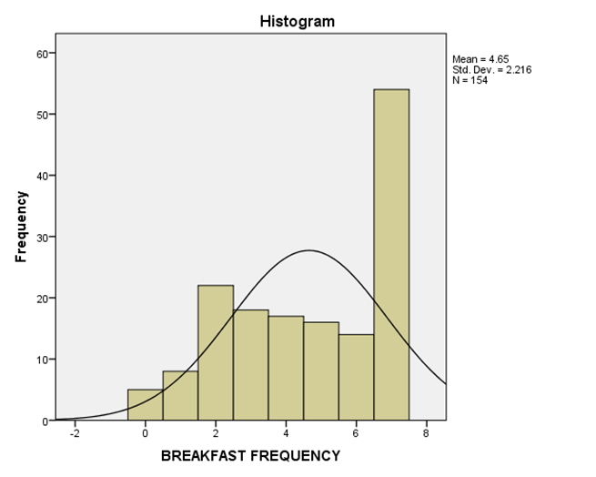
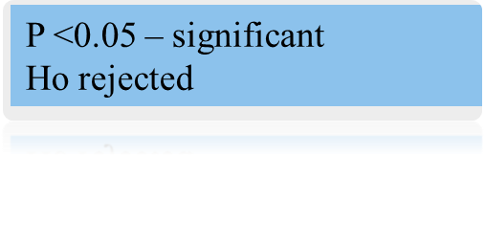
Null hypothesis: There is no significant association between frequency of taking breakfast and academic performance of students
Independent Samples Test
Factor | Academic performance | N | Mean | Standard Deviation | F | P
Breakfast frequency | Poor | 86 | 4.31 | 2.323
 | Good | 68 | 5.07 | 2.010
2.568
0.034
THERE IS SIGNIFICANT ASSOCIATION BETWEEN BREAKFAST FREQUENCY AND ACADEMIC PERFORMANCE.
CONCLUSION: STUDENTS WHO TAKE BREAKFAST LESS FREQUENTLY PERFORM POOR ACADEMIC PERFORMANCE.
skewness is -0.395
kurtosis is -1.178

Slide 22
Null hypothesis: There is no association between lecturer-related factors and academic performance of students.
Chi-square test
Factor
 | Poor | Good
Lecturer-related factor
<31 Poor | 14 (53.8%) | 12 (46.2%) | 26 (100%)
31-40 Average | 48 (55.8%) | 38 (44.2%) | 86 (100%)
>40 Good | 24 (57.1%) | 18 (42.9%) | 42 (100%)
Academic performance
N
X²
P
0.071
0.965
CONCLUSION: THERE IS NO ASSOCIATION BETWEEN LECTURER-RELATED FACTORS AND ACADEMIC PERFORMANCE OF STUDENTS.

Slide 23
STUDY LIMITATION
1) Insufficient specificity in questionnaire
For example, the factor of breakfast frequency. This gave a vague result of the association of the factor to academic performance. The specific details which could give a clearer picture of the association would be the type of food eaten and the amount.
2) The compliance of the student
Some students avoided to answer the questionnaires given. There were many questionnaires that are incomplete.
3) The subjective answers in the questionnaire
There are questions to relate the study habits and lecturer related factors. The factor is dependent on the perspective of the student. For example, a student’s definition of being prepared for a module may differ from student to student. These questions that need subjective answers may cause the results of the research to be inaccurate since there is no standardization.

Slide 24
CONCLUSION
The factors that associate with poor academic performances of UKM medical students are:
Race
Breakfast frequency
The factors that do not associate with poor academic performances of UKM medical students are:
Gender
Study habits
Time Spent for Extracurricular Activities
Time Spent for Family Activity
Frequency of Visit to Doctors
Lecturer

Slide 25
SUGGESTION FOR FUTURE RESEARCH
Provide more specific questionnaire with definition given to collect more precise data.
Interview associated with questionnaires could be done instead of self administered method.

Slide 26
REFERENCES
Eamonn Ferguson,David James,Laura Madeley, Factors associated with success in medical school: systematic review of the literature,2002
Haist, Wilson, Elam, Blue, & Fosson , 2006
Berard, M. Scott, Glen I. Spielmans, and Deana C. Julka, 20 Apr. 2012
Berard, M. Scott, Glen I. Spielmans, and Deana C. Julka. "Predictors Of Academic Achievement And Retention Amongcollege Freshmen: A Longitudinal Study." College Student Journal 38.1 (2004): 66-80. Academic Search Premier. Web. 20 Apr. 2012
Bean, J. P. and Bradley, R. K. (1986). Untangling the SatisfactionPerformance Relationship for College Students.The Journal of Higher Education 57, 393,412
Bartling, C. (1988). Longitudinal Changes in the Study Habits of Successful College Students Educational Psychological Measurement 48, 527,535
Credé M, Kuncel NR. Study habits, skills, and attitudes: the third pillar supporting collegiate academic performance. Perspect Psychol Sci. 2008;3(6):425–453
Ferguson E, James D, Madeley L. Factors associated with success in medical school: systematic review of the literature. BMJ. 2002;324(7343):952–957
Balbalosa, J.,F., 2010: Factors affecting performance of laboratory high school students at Laguna state polytechnic university academic year 2009-2010.
Principe, H., R., 2005: Factors influencing students’ academic performance in the first accounting course: a comparative study between public and private universities in Puerto Rico.

