Slide 1
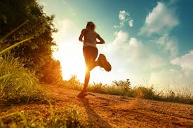
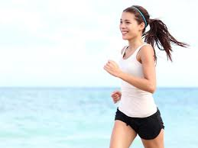
Relationship between Physical Activities with Body Mass Index (BMI), among first year and second year medical students of
Faculty of Medicine
Session 2015/2016 UKM
BY LAB 2

Slide 2
ACKNOWLEDGEMENT
A high appreciation to:
1. all lecturers of Department of Community Health especially Prof. Madya Dr. Azmi bin Mohd Tamil
2. our facilitator, Dr. Norfazillah Ab Manan ; and
3. all members of Lab 2

Slide 3
Abstract

Slide 4
This study is aimed to determine the relationship between gender, race, type of exercise, duration of exercise, frequency of exercise and BMI level, among the first and second year students session 2015/2016 in UKM Medical Faculty.
Hypothesis of our research are, male students have higher BMI compared to female students, Malay students have a higher BMI compared to other races, students who carry out vigorous physical activities, exercised at longer duration and at higher frequency have lower BMI compared to the one that does not.
Cross-sectional study was used with random sampling of sample size of 100 respondents. The descriptive and analytic analysis was applied using Microsoft Excel and SPSS version 17.0 which was presented in number, percentage and mean. Chi-square test was used to determine the relationship between the frequency and duration of physical activities with BMI level.

Slide 5
Preface-Introduction
Body Mass Index (BMI)
A simple index of weight-for-height that is commonly used to classify underweight, overweight and obesity in adults.

Slide 6
Preface-Background
Respondent
100 students from first and second year medical students
Location
UKM Cheras Campus

Slide 7
Literature review

Slide 8
Tanzania Journal of Health Research
Females had significantly higher prevalence of overweight than males throughout adolescence.
Rosnah MY and Mohd RH, Sharifah NSAR
Malays and Indians adolescents are likely to be overweight/obese meanwhile, Chinese are likely to be underweight.
American Journal Of Health
although nearly half of the overweight population currently meet the physical activity guidelines, these data indicate that the reported physical activity behaviours have not resulted in achieving normal weight status. Those who maintained a healthy weight were consistently more likely to engage in vigorous physical activity.

Slide 9
http://www.ncbi.nlm.nih.gov/pmc/articles/pmc1448495/
  It is found that those who does physical activity 3 or more times a week tend to have a healthy BMI compared to those who does physical activity less than 3 times a week, who have a slightly unhealthy BMI and those who does not do physical activity at all has unhealthy BMI.
http://jama.jamanetwork.com/article.aspx?articleid=197256
  As cited by the book (Exercise Physiology, 2013, Sharon A. Plowman, Denise L. Smith) increased in duration of physical activity is positively associated with a reduction in the total fat in a dose-response relationship, that is the more calories expended in exercise, the greater the fat loss, thus a lower BMI. Less than 150 min per week of exercise will result in minimal weight loss. Exercise between 150 to 225 min per week result in modest weight loss (2-3 kg) whereas 225-420 min per week of exercise results in 5-7.5 kg of weight loss over months or years of activity. Obviously there is a dose-response relationship operating in that higher doses can potentially provide larger losses from initial weight.

Slide 10
The Relationship between Physical Activity and Body Mass Index: Issues in Model Specification
  the duration of exercise is that matters in lowering or maintaining the BMI of undergraduate-college students. Such a finding is, however, not surprising since a student who has just started exercising and another who has been doing so for a longer period of time should not be expected to gain the same benefits in weight reduction or maintenance.
The Journal of the American Medical Association
  Significant weight loss and improved cardiorespiratory fitness were achieved from the high duration exercise compared to the other two classification.

Slide 11
PROBLEM FRAMEWORK
Ideal Body Mass Index
types of physical activity
frequency of physical activity
duration of physical activity
demographic pattern
gender, age, race

Slide 12
OBJECTIVEs
1. To determine the relationship between gender and BMI
2. To determine the relationship between types of exercise and BMI
3. To determine the relationship between duration of exercise and BMI
4. To determine the relationship between frequency of exercise and BMI
5. To determine the relationship between race and BMI

Slide 13
hypothesis
Female students are likely to have higher BMI than male students
Chinese students are likely to have lower BMI compared to non-Chinese students.
Students whom do vigorous exercise will achieve lower BMI.
Students whom do moderate exercise will achieve lower BMI.
Students who exercised in longer duration for vigorous exercise will be more likely to achieve ideal BMI.
Students who exercised in longer duration for moderate exercise will be more likely to achieve ideal BMI.
Moderate exercise more than four times a week will help students to achieve ideal BMI
Students who do vigorous exercise more than three times a week will have ideal BMI

Slide 14
METHODOLOGY
CROSS-SECTIONAL STUDY
Measures the relationship of variables ( manipulated and responding) in a defined population at particular time.
Often used to assess the prevalence of acute or chronic conditions, or to answer questions about the causes of disease or the results of intervention.

Slide 15
STUDY FIELD
UKM Cheras Campus
CONVENIENT SAMPLING
100 preclinical medical students in Pre-clinical building (HUKM) starting from 19- 23 October 2014
QUESTIONNAIRE
Self administered

Slide 16
Operational definition
1) Body mass index
High : ≥ 25 kg/m^2
Low : < 25kg/m2
Ideal : 18.0-22.9kg/m2
Non ideal : >22.9kg/m2 & <18.0kg/m2

Slide 17
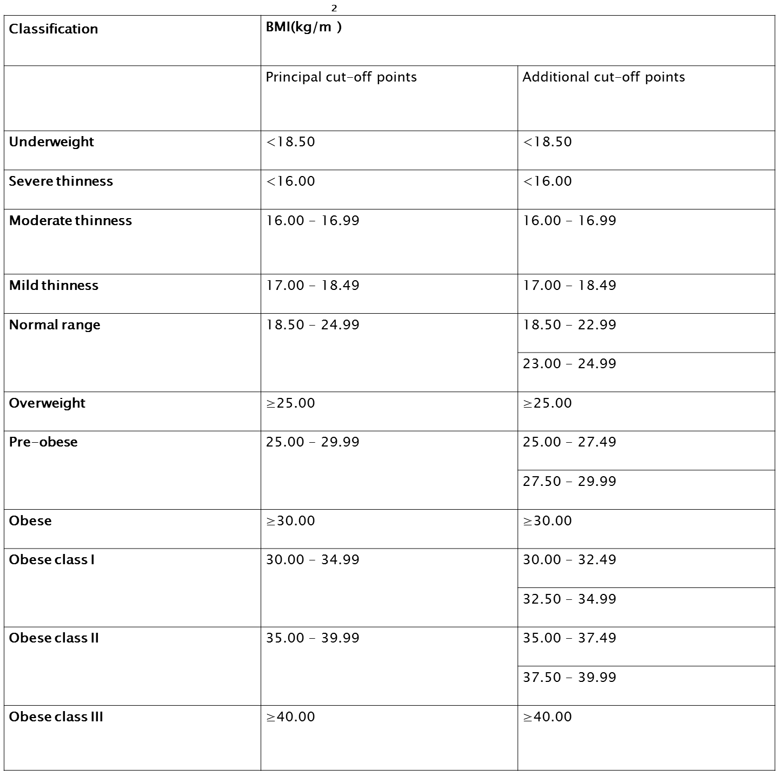
Source: Adapted from WHO 1995, WHO 2000 and WHO 2004.

Slide 18
2) Gender
Male
Female
3) Race
Chinese
non-Chinese
4) Frequency of Activity conducted
High duration
low duration
5) Duration of activity
long duration
short duration

Slide 19
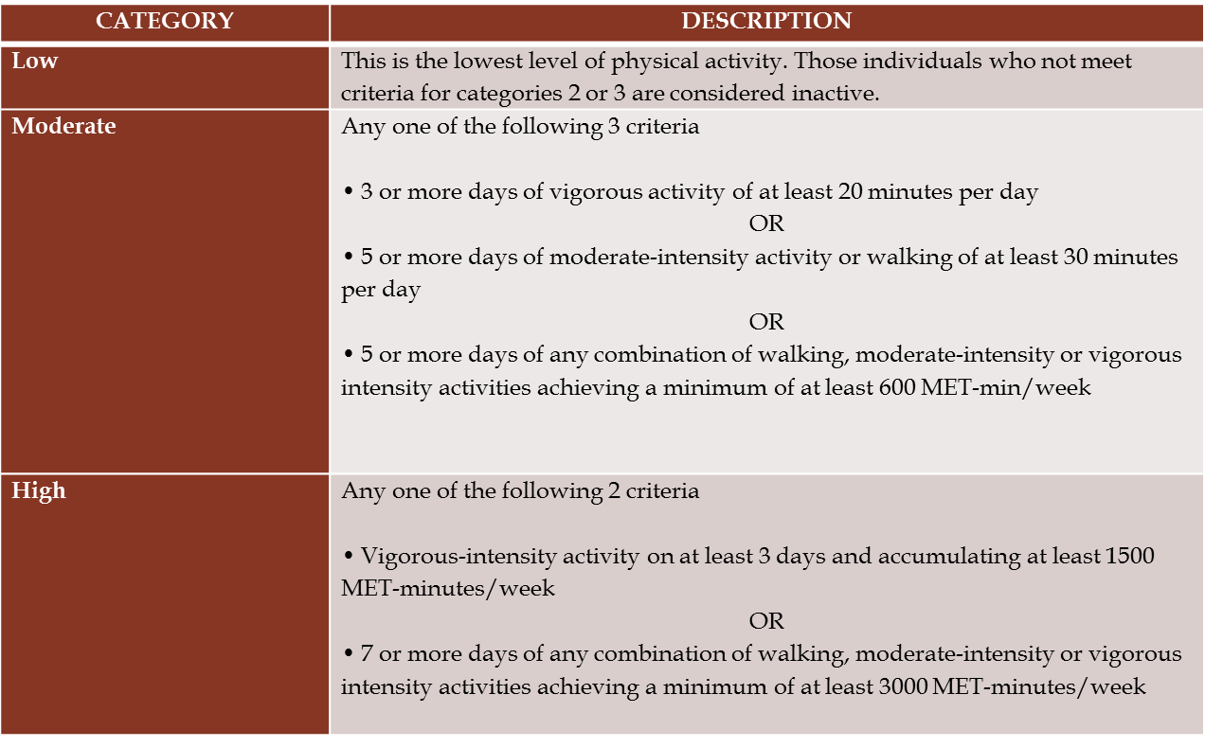
Table 2 : International Physical Activity Questionnaire Scoring Protocol
Source: IPAQ PHYSICAL ACTIVITY LEVELS (Based On Revised IPAQ Categories November 2005)
DATE OF LAST REVISION: November 22, 2010

Slide 20
questionnaires
Gender
Race
Physical activity
Duration of activity conducted
Frequency of activity conducted
Types of activities

Slide 21
RESULT
DESCRIPTIVE ANALYSIS

Slide 22
RESPONDENT : GENDER

Slide 23
RACES

Slide 24
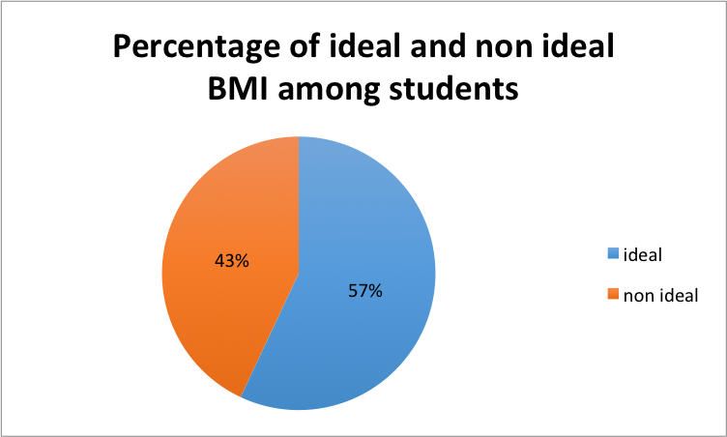
Classification of bmi - ideal and non-ideal

Slide 25
Vigorous activity

Slide 26
Frequency of vigorous activity

Slide 27
Duration of vigorous activity

Slide 28
Moderate activity

Slide 29
Frequency of moderate activity

Slide 30
Duration of moderate activity

Slide 31
Result analytic analysis

Slide 32
Null hypothesis : there is no significant association between gender and bmi
By using student t-test,
t = 1.185
p = 0.239
p > 0.05 ; insignificant.
Null hypothesis is not rejected.
Conclusion: There is no significant association between gender and BMI.
 | gender | N | Mean | Std. Deviation | T value | P value
BMI | male | 39 | 21.8715 | 3.47646 | 1.185 | 0.239
 | female | 61 | 20.9694 | 3.85461

Slide 33
Null hypothesis : there is no significant association between races (Chinese and non-chinese) and BMI.
By using student t-test,
t = 2.733
p = 0.007
p < 0.05 ; significant.
Null hypothesis is rejected.
Conclusion: There is significant association between races (Chinese and non-chinese) and BMI.
      Chinese students have lower bmi than the non-chinese students
 | chinese and non chinese | N | Mean | Std. Deviation
BMI | chinese | 34 | 19.9486 | 2.39368
 | non chinese | 66 | 22.0283 | 4.08369

Slide 34
Null hypothesis : there is no significant association between vigorous activity and BMI.
By using student t-test,
t = 0.929
p = 0.355
p > 0.05; insignificant.
Null hypothesis is not rejected.
Conclusion: There is no significant association between vigorous activity and BMI.
 | vigorous activity | N | Mean | Std. Deviation
BMI | vigorous | 56 | 21.6278 | 3.58923
 | non vigorous | 44 | 20.9310 | 3.88677

Slide 35
Null hypothesis : there is no significant association between moderate activity and BMI.
By using student t-test,
t = 2.574
p = 0.012
p < 0.05 ;significant.
Null hypothesis is rejected.
Conclusion: There is significant association between moderate activity and BMI.
Student whom do moderate activity will achieve lower BMI.
 | moderate activity | N | Mean | Std. Deviation
BMI | moderate | 31 | 22.7109 | 4.22701
 | non moderate | 69 | 20.6968 | 3.31509

Slide 36
Null hypothesis : there is no significant association between frequency of vigorous and BMI.
BMI classification |  | frequency of vigorous activity |  | Total
 |  | 3 or more | less than 3 |  | x² | P value
ideal n non ideal | ideal | 32 27.9% | 25 29.1% | 57 57.0% | 2.704ª | 0.100
 | non ideal | 17 21.1% | 26 21.9% | 43 43.0%
Total |  | 49 49.0% | 51 51.0% | 100 100.0%
By using Chi-Square Test,
x² = 2.704
p = 0. 1
p > 0.05 ; insignificant.
Null hypothesis is not rejected.
Conclusion: There is no significant
association between
frequency of vigorous
and BMI.

Slide 37
Null hypothesis : there is no significant association between frequency of moderate activity and BMI.
BMI classification |  | frequency of activity (moderate) |  | Total
 |  | 4 or more | Less than 4 times |  | x² | P value
ideal n non ideal | ideal | 17 17.7% | 40 39.3% | 57 57.0% | 0.86 | 0.770
 | non ideal | 14 13.3% | 29 29.7% | 43 43.0%
Total |  | 31 31.0% | 69 69.0% | 100 100.0%
By using Chi-Square Test,
x² = 0.86
p = 0.770
p > 0.05 ; insignificant
Null hypothesis is not rejected.
Conclusion: There is no significant
association between
frequency of moderate
activity and BMI.

Slide 38
Null hypothesis : there is no significant association between duration of vigorous activity and BMI.
BMI classification |  | duration of vigorous activity |  | Total
 |  | 60 minutes or more | Less than 60 minutes |  | x² | P value
ideal n non ideal | ideal | 21 18.8% | 36 38.2% | 57 57.0% | 0.885 | 0.347
 | non ideal | 12 14.2% | 31 28.8% | 43 43%
Total |  | 33 33.0% | 67 67.0% | 100 100.0%
By using Chi-Square Test,
x² = 0.885
p = 0.347
p > 0.05 ; insignificant
Null hypothesis is not rejected.
Conclusion: There is no
significant association
between duration of
vigorous activity and BMI.

Slide 39
Null hypothesis : there is no significant association between duration of moderate activity and BMI.
BMI classification |  | duration of moderate activity |  | Total
 |  | 90 minutes or more | Less than 90 minutes |  | x² | P value
ideal n non ideal | ideal | 7 6.3% | 50 50.7% | 57 57.0% | 0.222 | 0.637
 | non ideal | 4 4.7% | 39 38.3% | 43 43.0%
Total |  | 11 11.0% | 89 89.0% | 100 100.0%
By using Chi-Square Test,
x² = 0.222
p = 0.637
p > 0.05 ; insignificant
Null hypothesis is not rejected.
Conclusion: There is no
  significant association
  between duration of moderate
  activity and BMI.

Slide 40
Discussion

Slide 41
Race and BMI
  There is significant association between races (Chinese and non-chinese) and BMI.
  Chinese students have lower bmi than the non-chinese students.
  Our study is also supported by study conducted by Rosnah MY, Mohd RH, Sharifah NSAR in Anthropometry dimensions of older Malaysians: comparisons of age, gender and ethnicity. Asian Soc Sci 5:133-140
Moderate activity and bmi
  There is significant association between moderate activity and BMI.
  Student whom do moderate activity will achieve lower BMI.
  Our study is also supported by study conducted by Spees CK, Health Sciences and Medical Dietetics in Differences in amounts and types of physical activity by obesity status in US adults.

Slide 42
Gender and BMI
There is no significant association between body mass index between male and female students
This is because research is conducted only among first and second medical students in ukm which are small sample size and not randomised.
it is supported by article written by Fernando Araújo et al. entitled Gender-related associations of increased BMI with clinical and laboratory (2007).

Slide 43
Type of physical activity and BMI
There is no significant association between types of physical activity and BMI among 1st and 2nd year medical students.
This is because our study is conducted in small population which is 100 respondents and a small age gap between respondents.

Slide 44
Duration of physical activity and BMI
there is no significant association between duration of physical activity with BMI.
longer or shorter duration of physical activity done by the students will have no effect on their BMI
This is supported by previous study done by Chetna et al (2012) which suggests there is no correlation between duration of physical activity and BMI

Slide 45
Frequency of physical activity and BMI
There is no significant association between frequency of physical activity with BMI among 1st and 2nd year medical students.
This is because our study is conducted in small population which is 100 respondents.

Slide 46
Limitation and Suggestion
No. | Limitation | Suggestion
1. | Small sample size will reduce the accuracy of the final outcomes | Increase the sample size
2. | The cross sectional study by conducting self report measure questionnaire | longitudinal study is the most accurate and significate result outcomes
3. | Reliability and validity of self-reported: underestimate their weight and overestimate their height | Use more direct methods to measure height and weight
4. | Small age gap between the respondents | Wider age gap of more than 6 years would be preferable to show significant changes in BMI

Slide 47


