Slide 1
Prevalence of Stress, Stressors and Coping Mechanism in Second Year UKM Medical Students : A Cross-sectional Study
LABORATORY 4
Prof. Madya Azmi bin Mohd Tamil
Facilitator : Dr Mohd Saiful Azlan

Slide 2
LAB 4
SINARAN SAMSURI GA02540
SITI NUR WARDAH BINTI ISHAK A143628
MUHAMMAD SYAHIR AFHAM BIN KAMARUDDIN A143655
MUHAMAD NAIM BIN ZULKIFLE GA02523
MUHAMMAD HAZIQ BIN ABDUL SUKI A148987
SHAH – ABAS MUHAMAD BIN MD SHAH A147319
WONG JENG YUAN A149598
CHAN ZI NIAN A148513
NUR ALYANIE BINTI ABDUL MAJI A149741
CHAI KAR YEE A149669
NORDIANA IZIANY BINTI NORDIN A149100
LOUSHINNAH D/O MOHAN GA02520
SITI MARYAM BINTI KAMARUDIN A147310
NUR NADWIN YUSHAHIRA BINTI MOHD YUSOFF A148230
NURUL AYUNI SYAFIQAH BINTI MAT ROPI A147946
NURUL FARZANA BINTI BIDIN A149505
LEE PEI CHIEH A149049
KRIMIYA BINTI YUSOF A143704

Slide 3
Introduction
What is stress?
“a situation where demands on a person exceed that person’s resources or ability to cope”.
(Stress Management Society)
“the reaction people may have when presented with demands and pressures that are not matched to their knowledge and abilities and which challenge their ability to cope” (WH0, 2003)
Justification
“Students are subjected to different kinds of stressors, such as the pressure of academics with an obligation to succeed, an uncertain future and difficulties of integrating into the system. “
(Fish & Nies, 1996 )
“Information on sources and severity of stress and coping strategies are lacking among medical students in medical schools”. (Sarina MY, 2011)

Slide 4
General Objective
To determine the level of stress and stressors among second year medical student and to identify the stress coping mechanisms used by second year medical students of Faculty of Medicine, UKM.

Slide 5
Specific Objectives
To determine the level of stress among second year medical students of Faculty of Medicine, UKM.
To determine whether gender has effect on the stress level among students.
To determine the stressors among students.
To determine the most commonly used coping mechanisms among students.

Slide 6
Hypothesis
Medical students are generally stressed.
Female students have a higher stress level compared to male students.
Stressors associated with the stress status among students include academic-related stressors, interpersonal-related stressors, and group activities-related stressors.
The most common cope used by students is through religious approach.

Slide 7
Source : Psychological Stress Among Undergraduate Medical
Students by M S Sherina, MMed, L Rampal, PhD, N Kaneson, BSc
Department of Community Health, Faculty of Medicine and Health Sciences, Universiti Putra Malaysia, Selangor, Malaysia.
LITERATURE REVIEW
Prevalence of stress
“41.9% of the medical students were found to have psychological stress which was significantly association with depression”
“The prevalence of psychological stress was only slightly higher among the females compared to the males.”
(Sherina Mohd. Sidik,2003)

Slide 8
LITERATURE REVIEW
STRESSOR (GARS)
“ Group related activity was found to be the main factor affecting psychological distress in preclinical medical students in Universiti Putra Malaysia in 2014.” (Prof. Dato Dr. Lye Munn Sann, 2014)
Source : Prevalence and risk factors of Stress, Anxiety and
Depression among Preclinical Medical students in
Universiti Putra Malaysia in 2014 by Maher D. Fuad Fuad, Munn Sann Lye *, Normala Ibrahim, Siti Irma Fadhillah binti
Ismail, Phang Cheng Kar, Faculty of Health and life sciences, Universiti Putra Malaysia, Selangor, Malaysia.

Slide 9
Source : A study on stress, stressors and coping strategies among Malaysian medical students by Muhamad Saiful Bahri Yusoff, Liew Yen Yee, Ling Heng Wei, Tan Chin Siong, Loke Hon Meng, Lim Xue Bin, Ahmad Fuad Abdul Rahim , Universiti Sains Malaysia, Kelantan, Malaysia.
STRESSOR (ARS)
“ The major stressors were related to academic and contributing factors of stress were related to university, coping strategies, types of stressors and parents income status” ( Muhamad Saiful Bahri Yusoff, 2011)

Slide 10
Source : Stress among Medical Students in Malaysia by Abdus Salam, Rabeya Yousuf, Sheikh Muhammad Abu Bakar and Mainul Haque, Malaysian Public Universities.
STRESSOR (IRS)
“Year of study, financial problem and relationship problem with parents, siblings and lecturers were the significant determinants of stress among medical students “ (Rabeya Yousuf,2013)

Slide 11
Literature Review
Coping mechanism
“The findings revealed that the five commonest adopted coping strategies by Malaysian medical students were religion, active coping, positive reframing, acceptance and planning.” (MSB Yusoff, 2011)
Source : Stress, Stressors and Coping Strategies among Malaysian Medical Students by Muhamad Saiful Bahri Yusoff, Liew Yen Yee, Ling Heng Wei, Tan Chin Siong, Loke Hon Meng, Lim Xue Bin, Ahmad Fuad Abdul Rahim. Published on 2011.

Slide 12
PROBLEM FRAMEWORK
GARS
ARS
STRESS
STRESSORS
COPING MECHANISM
IRS

Slide 13
Methodology
Research design:
- cross-sectional study design
Study field:
-PPUKM Cheras
Study population:
- 100 second year student in medical faculty in UKM.
Sampling technique:
- simple randomization by random generated numbers via Microsoft Excel

Slide 14
Data collection tools:
- the questionnaire consist of 3 parts which are
PSI(measure level of stress).
MSSQ (identify the most common stressor)
Brief Cope(coping mechanism)
Data analysis
-SPSS to analyse the data by descriptive and analytical statistic(bivariate analysis)

Slide 15
Operational Definition
STRESS LEVEL (based on PSI)
-score less than 36 is considered not stress.
-score 36 and above is considered stress.
STRESSORS (based on MSSQ)
0= causing no stress at all
1= causing mid stress
2= causing moderate stress
3= causing high stress
4= causing severe stress
COPING MECHANISM (based on BRIEF COPE)
1 = I haven't been doing this at all
2 = I've been doing this a little bit
3 = I've been doing this a medium amount
4 = I've been doing this a lot

Slide 16
Analytical analysis
Level of significance: 5%

Slide 17
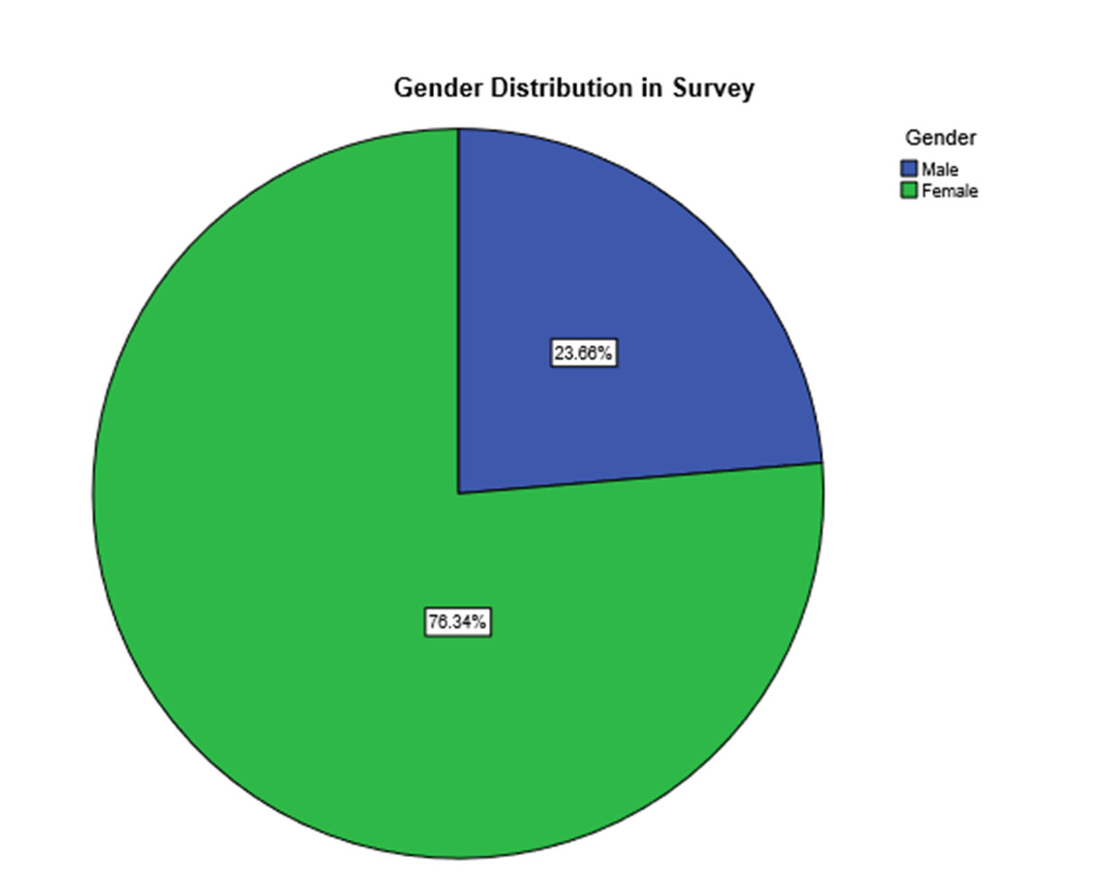
Socio-demographic profile of participants

Slide 18
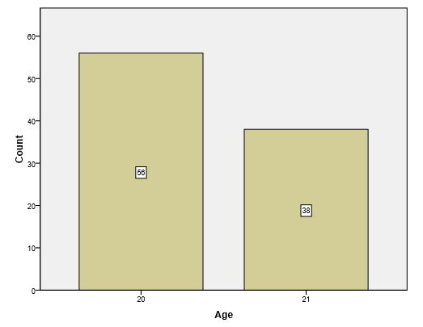
Age Distribution in Survey

Slide 19
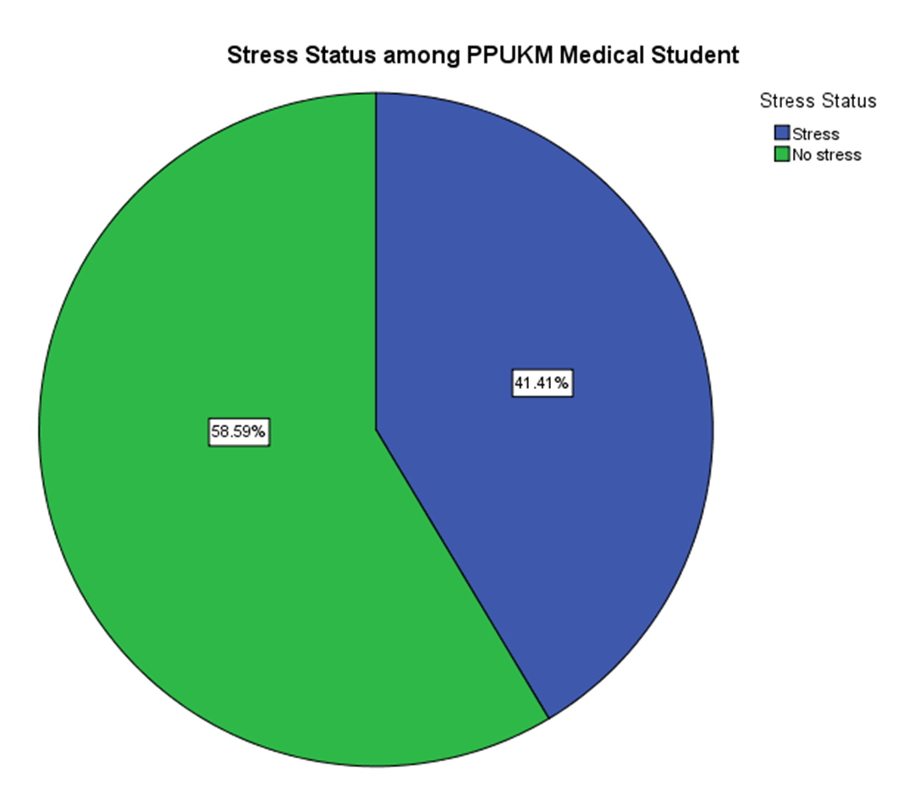
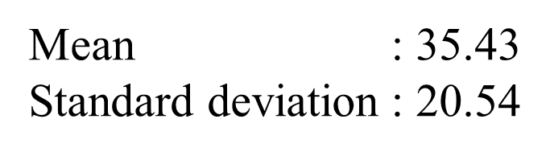

Slide 20
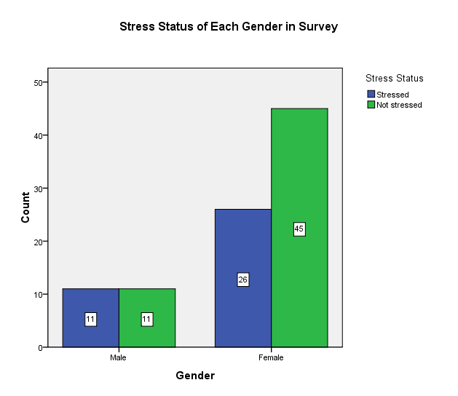
Gender and stress level
- Pearson Chi-Square

Slide 21
Analytical analysis

Slide 22
Gender and Stress status
- Chi-square test

Slide 23
 | Stress Level |  | PSI Score
 | Stress | Not Stress | Mean | Standard deviation
Male | 11 (50.0%) | 11 (50.0%) | 36.45 | 17.23
Female | 26 (36.6%) | 45 (63.4%) | 35.53 | 21.71
From the table, 50.0% of the male students is
stressed while 36.6% of the female is stressed.
The mean PSI score (indicator for stress level) of
male is 36.45 ± 17.23 which is higher than female
35.53 ± 21.71.

Slide 24
H₀: There is no association between gender and stress level
Associating Factor | Pearson Chi-Square | Degree of freedom | P-value
Gender | 1.255 | 1 | 0.263
Even though larger proportion of male is stressed
with higher mean PSI score, the difference is
insignificant with p>0.05.
H₀ is not rejected.
There is no association between gender and stress
Status

Slide 25
Stressor and stress status
- T-test

Slide 26
H₀: There is no significant difference of score of stressors between stress and non-stress medical students.
MSSQ | Stress Status |  | T-test | P-value
 | Stress Mean (SD) | Not stress Mean (SD)
Academic Related Stressors (ARS) | 2.63 (0.64) | 2.29 (0.68) | 2.46 | 0.016 (significant)
Interpersonal Related Stressors (IRS) | 1.93 (1.14) | 1.53 (1.01) | 1.80 | 0.076 (not significant)
Group Activities Related Stressors (GARS) | 2.26 (1.00) | 1.76 (0.93) | 2.50 | 0.014 (significant)
From the table, the mean MSSQ score for all 3 categories are higher in stressed students.
The highest mean score falls to ARS, thus ARS is believed to be the commonest stressor
among stressed medical students.
Based on the T-test, the results for ARS and GARS are significant (p< 0.05).
H₀ is rejected.
ARS and GARS have significant contribution to the stress status among medical students.

Slide 27
Coping strategies
- correlation to stress status

Slide 28
Coping Strategies | Stress Mean (SD) | Coping Strategies | Not Stress Mean (SD)
religion | 3.54 (0.98) | religion | 3.20 (0.79)
planning | 3.17 (0.74) | positive reframing | 3.03 (0.82)
self-distraction | 3.08 (0.74) | planning | 2.99 (0.75)
instrumental support | 3.07 (0.86) | acceptance | 2.95 (0.79)
active coping | 3.00 (0.77) | self-distraction | 2.87 (0.81)
Based on the table :
The five most commonly used coping strategies among stressed students are
religion (3.54), planning (3.17) , self-distraction (3.08), instrumental support (3.07)
and active coping (3.00).
2. The five most common coping strategies used by not stressed students are
religion (3.20), positive reframing (3.03), planning (2.99), acceptance (2.95) and
self-distraction (2.87).
3. Religion is the most common coping strategies among stressed and not stressed
students. It also shows negative correlation with stress level.

Slide 29
Coping Strategies | Correlation | Statistical value
Religion | -0.12 | 0.071
Active coping | -0.065 | 0.434
Self distraction | -0.042 | 0.561
Planning | -0.039 | 0.702
Instrumental support | -0.030 | 0.728
The table shows some of the common coping strategies used among stressed
and not stressed medical students.
All of the coping strategies show negative correlation with stress level.
This suggests that with the use of these coping strategies, the stress level can be reduced.

Slide 30
conclusion
There is no association between gender and stress status
ARS and GARS have significant contribution to the stress status among medical students
Religion is the most common coping strategies among stressed and not stressed students.

Slide 31
LIMITATIONS OF THE STUDY
1) Sample size
-Research were only doing for a 100 medical students which is small in number from all UKM medical students .
-Cannot represent a true picture of the all medical students.
2) Questionnaire
-The students’ response in questionnaire may not accurate or the students misunderstood the questions.
Students may also feel uninterested in answering the questionnaire thus giving wrong answers.
3) Timing
-the questionnaire was distributed after the students finished sitting for their EOM
-the answers provided by the students may not represent the real stress situation.

Slide 32
SUGGESTIONS FOR FUTURE RESEARCH
We should conduct the study among the students in variety fields.
Increase the sample size that represent the general population.
We should conduct our research before and after exam to get more accurate results.

Slide 33
References
1. Psychological Stress Among Undergraduate Medical Students by M S Sherina, MMed, L Rampal, PhD, N Kaneson, BSc
Department of Community Health, Faculty of Medicine and Health Sciences, Universiti Putra Malaysia, Selangor, Malaysia.
2. Prevalence and risk factors of Stress, Anxiety and Depression among Preclinical Medical students in Universiti Putra Malaysia by Maher D. Fuad Fuad, Munn Sann Lye *, Normala Ibrahim, Siti Irma Fadhillah binti Ismail, Phang Cheng Kar, Faculty of Health and Life Sciences, Universiti Putra Malaysia, Selangor, Malaysia, 2014
3. Stress, stressors and coping strategies among Malaysian medical students by Muhamad Saiful Bahri Yusoff, Liew Yen Yee, Ling Heng Wei, Tan Chin Siong, Loke Hon Meng, Lim Xue Bin, Ahmad Fuad Abdul Rahim , Universiti Sains Malaysia, Kelantan, Malaysia, 2011.
4. Stress among Medical Students in Malaysia by Abdus Salam, Rabeya Yousuf, Sheikh Muhammad Abu Bakar and Mainul Haque, Malaysian Public Universities
5. Psychological Well-being, Stress and Coping Style among UiTM Preclinical Medical student by Azlina Wati Nikmat, Mariam Mohamad, Anisah Omar and Salmi Razali from Research Management Institute, Universiti Teknologi Mara (UiTM), September 2010.

