Slide 1
LAB 6
Facilitator : Dr. Jamilah
TOPIC: The Association between Internet Addiction and Academic Performances of UKM Cheras Medical Students.

Slide 2
INTRODUCTION
Internet is a good source for learning and research, little empirical data has substantiated this claim by specifically linking time and effort spent on the Internet for school related information seeking to academic performance.
The internet has been touted as a premiere educational tool driving schools to integrate internet services among their classroom environments.
However, one survey revealed that eighty-six percent of responding teachers, librarians, and computer coordinators believe that Internet usage by children does not improve performance.

Slide 3
JUSTIFICATION
Theoretical Implications
This study will give a significant proof that there is a relationship between internet addiction and academic performance of students.
Practical Implications
Reveals the negative impacts for excessive internet usage.
Students can take note of the negative effects towards academic performance and try to control and eliminate their problem in internet addiction.

Slide 4
LITERATURE REVIEW
Since the mid-1990s, the Internet has experienced unprecedented growth in both its size and number of users around the world (Rotsztein, 2003)
Internet addiction may affect academic performances of students. Internet addiction is ‘‘an individual’s inability to control their Internet use, which in turn leads to feelings of distress and functional impairment of daily activities” (Shapira, N., Lessig, M., Goldsmith, T., Szabo, S., Lazoritz, M., Gold, M. et al. (2003)).

Slide 5
PROBLEM STATEMENT
What is the level of internet addiction among UKM Cheras medical students?
What is the effect of internet addiction towards academic performances of UKM Cheras medical students?
What are the other factors that affect academic performance?

Slide 6
GENERAL OBJECTIVE
To determine the association between internet addiction and academic performances of UKM Cheras medical students

Slide 7
SPECIFIC OBJECTIVES
To investigate the level of internet addiction among UKM Cheras medical students.
To find the effect of internet addiction towards academic performances of UKM Cheras medical students.
To identify other factors that affecting academic performance.

Slide 8
HYPOTHESIS
Null Hypothesis:
There is no effect of internet addiction towards academic performances of UKM Cheras medical students.
Alternative Hypothesis:
The higher the level of internet addiction, the lower the academic performances of UKM Cheras Medical students

Slide 9
METHODOLOGY
a) Cross-sectional study
measure the relationship of variables in a defined population at one particular time.
b) Study field
UKM Cheras Medical Faculty

Slide 10
METHODOLOGY
c) Sample population
86 2nd year medical students in UKM Cheras Medical Faculty
d) Duration
8 weeks starting from 5 October 2015 until a week from the date of presentation which is on 26 November 2015
e) Tools
Questionnaire

Slide 11
METHODOLOGY
f) Data analysis
Statistical Package for Social Sciences (SPSS) version 21.0 software.
g) Analytic statistic
ANOVA test
Independent t-test

Slide 12
Questionnaire
Gender
Age
Race
Family income
Parents education background
Internet usage
CGPA

Slide 13
RESULT

Slide 14
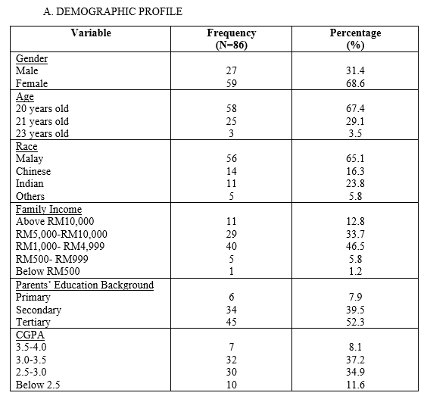
1. DESCRIPTIVE ANALYSIS

Slide 15
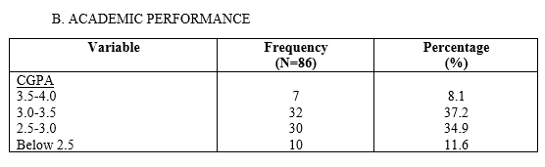
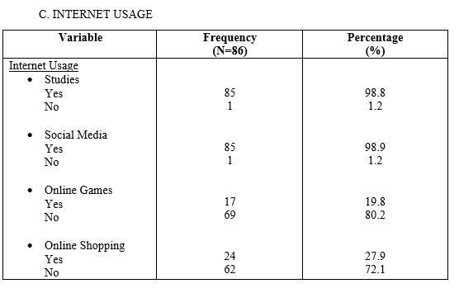
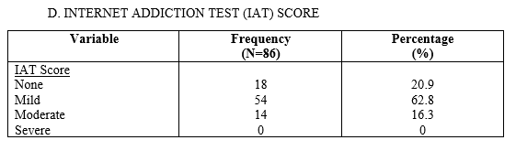
Most of the student has a mild score of the IAT. There is no severe internet addiction cases.

Slide 16
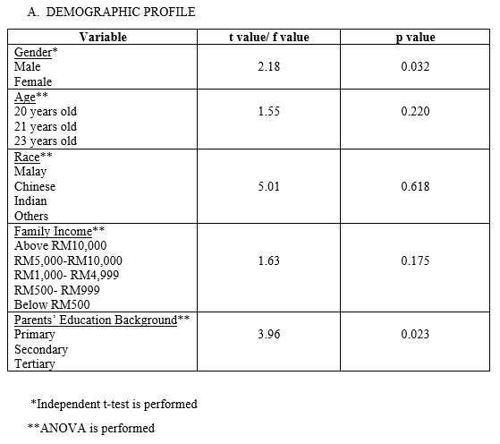
2. BIVARIATE ANALYSIS-
FACTORS AFFECTING ACADEMIC PERFORMANCES
There is a difference in academic performance between male and female students.
There is a difference in academic performance between students with different parents’ education background.

Slide 17
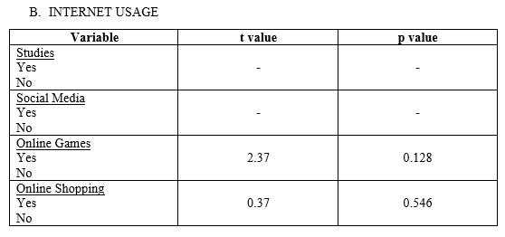
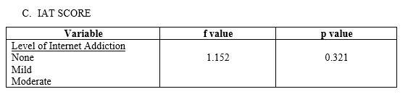
There is no difference of academic performance between different levels of internet addiction.

Slide 18
DISCUSSION
Gender
A study in Turkey done by T. Koyuncu, A. Unsal and D. Arslantas reported that there is no difference was observed between men and women in terms of internet addiciton while a study by Widyanto and McMurran (46) and Tsitsika et al. (47) showed that there is evidence that men are more predisposed to internet addiction. Our study showed significant association between gender and internet addiction with t = 2.18 and p = 0.032. Reason is unclear because tool that we used has no power to detect differences in these two gender.

Slide 19
Family income
A study done by Sahin M. shows that the students with higher family income is more predisposed to internet addiction compared to lower. Our study reported that there is no significant difference between family income and internet addiction with t = 1.63 and p = 0.175. This can be due to the availability of free Wi-Fi at the hostel and faculty.

Slide 20
Parents education background
A study in Turkey done by T. Koyuncu, A. Unsal and D. Arslantas reported that the prevalence of internet addiction increased with increasing maternal education level. However, maternal education level was not found to be a risk factor for internet addiction in logistic regression analysis. There are also several other studies reporting no association between internet addiction and educational status of the mother. Our study showed that there is a significant difference between parents education background and internet addiction with t = 3.96 and p = 0.023.

Slide 21
Internet Usage
Our study showed that the frequency of internet usage is mainly for studies and social media with 98.8% and 98.9% respectively. This result corresponds with Livingstone and Bober (2005) who reported that 90% of the participants used the Internet for school or college work.

Slide 22
Internet Addiction Test
Our study reported that there is no significant difference between internet addiction and academic performance. This is because we did not make it more specific into weekdays and weekends. A study done by Harlina H. S. et al. showed that there is significant difference between internet addiction and academic performance during weekdays while there is no significant difference between internet addiction and academic performance during weekends.

Slide 23
STUDY LIMITATION
SAMPLE SIZE
Research only focus on the medical students in UKM
Small sample size, only involved 86 students
SOLELY INVESTIGATED THE EFFECTS OF INTERNET ADDICTION ON STUDENTS CGPA
The variable is too specific
RECALL BIAS
Used self reported rather than direct measure of internet usage use such as Facebook and other variables

Slide 24
SUGGESTION
Use bigger sample size, not just second year medical students because it does not represent the true picture of the community.
The sample should involve other faculty because it may vary from general population
Should include more social variable such as health status of the student and social dysfunction.
Direct measure of the internet usage and other variables rather than self reported

Slide 25
STRENGTH
Low cost
Objectives were achieved in a short period of time

Slide 26
CONCLUSION
From our study it shows that there is no effect of internet usage on academic performance, but medical students must make sure that they do not cross the limit of internet usage so as it does not affect their academic performance.

Slide 27
REFERENCES
Suhail K, Bargees Z (2006). Effects of excessive internet use on undergraduate students in Pakistan. Cyber Psychol. Behav. 9(3):297-307.
Kim JH (2004). A Study on Problem and Policy of Youth internet addiction. Korean J. Fam. Soc. Work 9(2):21-34.
Jeong TG (2005). The Effects of Internet Addiction and Self Control on Achievement of Elementary School Children). Korean J. Yeolin Educ.
13(1):143-163.
Weiser EB (2000). Gender Differences in Internet Use Patterns and
Internet Application Preferences: A Two-Sample Comparison. Cyber
Psychol. Behav. 3:167-178.
Scherer K (1997). College Life On-Line: Healthy and Unhealthy Internet Use. J. College Student Dev. 38:655-665
Morahan-Martin J, Schumacher P (2000). Incidence and correlates of pathological Internet use among college students. Comput. Hum. Behav.16:13-29

Slide 28


