Slide 1
HEALTH LITERACY AND ITS ASSOCIATED FACTORS AMONG 2ND YEAR MEDICAL STUDENTS OF FACULTY OF MEDICINE UKM
Lab 7
Medicine & Society
Faculty of Medicine
Universiti Kebangsaan Malaysia
Prof Madya Dr Azmi Bin Mohd Tamil
Facilitator : Dr Siti Nurbaya

Slide 2
LAB 7
SHAMSUL AKMAL BIN SAMSUL BAHRI | A147935
AMIRUZAIR BIN AZMIN | A147272
TIONG LI MIN | A150236
SITI NUR A’IN BT. MOHD. AYOB | A143662
IZZAH SHAHIRA BT. SHAH JAHAN | GA02515
WONG LAI PHING | A147419
VIKNESH A/L KUPPUSAMY | A148001
FATIN NOR SHAKILA BINTI ZAINAL | A148574
NURSUHAIRA BINTI SULAIMAN | A143705
NAJAT EMIR BT. MOHAMMAD ARIFF EMIR | A148051
NUR AMALINA BT. MOHAMED AZHAR | GA02576
NURSYAHIRAH BINTI ABDUL HALIM | A147318
MOHAMMAD AFNAN SHAKIR BIN MOHD NASIR | A149554
TONG SIEW QI | A147424
AINI SYAHIRAH BINTI SHAMSUL | GA02502
KAMALESHINI A/P SHANMUGAM | GA02574
MOHAMMAED FITRI BIN AHMAD TAKRI | GA02555
TAN TIAN LEE | A148878
MUHAMMAD NUR AKMAL B. AZIZUDDIN | A147316

Slide 3
Introduction
Health literacy is defined as the degree to which individuals can obtain, process, and understand the basic health information and services they need to make appropriate health decision (Lynn Nielsen-Bohlman 2004)
Socio demographic factors that have been seen to be associated with health literacy level are sex, age, race, education, income and marital status (Jovic-Vranes et al. 2009; Martin et al. 2009; Shah et al. 2010)

Slide 4
General objectives
Specific objectives
To investigate the health literacy level among second year UKM medical students and its associated factors.
To determine relationship between gender and health literacy level among 2nd year medical students
To determine relationship between races and health literacy level among 2nd year medical students
To determine relationship between BMI and health literacy level among 2nd year medical students
To determine relationship between parent’s income and health literacy level among 2nd year medical students
To determine relationship between 1st year CGPA and health literacy level among 2nd year medical students
To determine relationship between MUET and health literacy level among 2nd year medical students

Slide 5
Hypothesis
Students who have high CGPA of first year examination have higher health literacy level.
Chinese students have higher health literacy level.
Students who have high MUET band have higher health literacy level.
Female students have higher health literacy level compared to male students.
Students who come from a good financial status family have higher health literacy level.
Students who have normal BMI have higher health literacy level.

Slide 6
Literature Review
Research Finding | Source
Gender “More women than men had adequate health literacy” | Health Literacy Instrument in Family Medicine by Journal American Board of Family Medicine (JABFM), 2009.
Parents’ Income “Inadequate health literacy was associated with social disadvantage” | Risk associated with low functional health literacy in an Australian population by Robert J Adams et al. 2009.
Educational Status “Those who receive only primary or secondary education tend to have limited health literacy skills” | Exploring health literacy and difficulty in comprehending pediatric medication labels among caregivers in Malaysia by Journal of Pharmaceutical Health Service Research (JPHSR), 2015.
Body Mass Index (BMI) “There are no association of BMI with health literacy. However, BMI category was 4 out of 5 predictor in the logistic regression analysis” | Health Literacy Instrument in Family Medicine by Journal American Board of Family Medicine (JABFM), 2009.

Slide 7
Conceptual Framework
DEMOGRPHIC FACTORS
GENDER
RACE
EDUCATION LEVEL
HEALTH STATUS
HEALTH LITERACY
1ST YEAR CGPA
MUET BAND
BMI
SOCIOECONOMIC
PARENT’S INCOME

Slide 8
Methodology
CROSS-SECTIONAL STUDY | 2ND year medical students 2015/16
STUDY FIELD | UKM CAMPUS CHERAS
SYSTEMATIC RANDOM SAMPLING | Total population = 187, exclude 19 lab members. From list of names in alphabetical order, chose every 2 out of 3. With a response rate is 90%, total respondents was 101. 27th October 2015 to 29th October 2015
QUESTIONNAIRE | Newest Vital Sign (NVS) = valid and reliable screening tool that measures health literacy. Consist of 6 questions.
DATA COLLECTION | Face to face interview, Google Form, download the result in Excel Sheet.

Slide 9
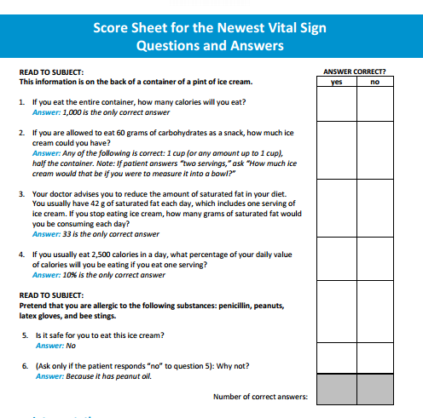
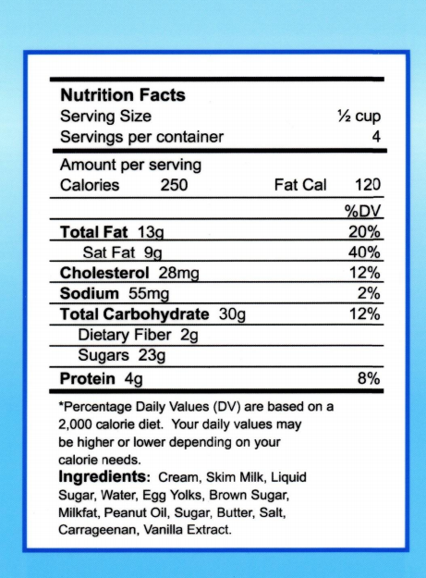

Slide 10
Operational Definition
Gender Male Female Race Malay Chinese Indian Others BMI Underweight (<18.5) Normal (18.2-22.9) Overweight (≥ 23) | CGPA Low : Below 3.5 High : Above 3.5 MUET Band 3 Band 4 Band 5 Parent’s Income Low : below RM 2 500 High : above RM 2 500

Slide 11
DATA ANALYSIS | Microsoft Excel 2010 and SPSS version 20.0
ANALYTIC STATISTIC | Student T-test ANOVA Pearson correlation Chi Square Significant level : p<0.05

Slide 12
DESCRIPTIVE AND STATISTICAL ANALYSIS

Slide 13
SOCIO-DEMOGRAPHIC DATA
Variables |  | Percentages (%) N=101
 |  | n | %
Gender | Male | 36 | 35.64
 | Female | 65 | 64.36
Race | Malay | 67 | 66.34
 | Chinese | 25 | 24.75
 | Indian | 7 | 6.93
 | Others | 2 | 1.98
Parent’s income | < RM 2 500 | 30 | 29.7
 | ≥ RM 2 500 | 71 | 70.3

Slide 14
HEALTH STATUS

Slide 15
EDUCATION FACTORS (n= 101)

Slide 16
 | Distribution |  | Score |  | P value
 | n | % | mean | SD
Gender ^{α} Male Female | 36 65 | 35.64 64.36 | 4.25 4.42 | 1.574 1.509 | 0.605
Race ^{β} Malay Chinese Indian Others | 67 25 7 2 | 66. 34 24.75 6.93 1.98 | 4.42 4.24 4.00 5.00 | 1.416 1.786 1.915 0.00 | 0.808
Income ^{α} < RM 2 500 ≥ RM 2 500 | 30 71 | 29.7 70.3 | 4.37 4.35 | 1.712 1.455 | 0.965
MUET ^{β}* Band 3 Band 4 Band 5 | 48 44 9 | 47.52 43.56 8.91 | 3.98 4.61 5.11 | 1.537 1.482 1.269 | 0.040
CGPA ∞ | - | - | 2.98 | 0.423 | 0.670 (r = 0.043)
Variable BMI ^{Ω} | Health Literacy Level |  | P value
 | Limited HL (0-3) | Adequate HL (4-6)
Underweight Normal Overweight | 4 (40%) 15 (23.8%) 10 (35.7%) | 6 (60%) 48 (76.2%) 18 (64.3%) | 0.362
^{α}Student’s t test
^{β} ANOVA
∞Pearson correlation
^{Ω}Chi Square test
*P < 0.05

Slide 17
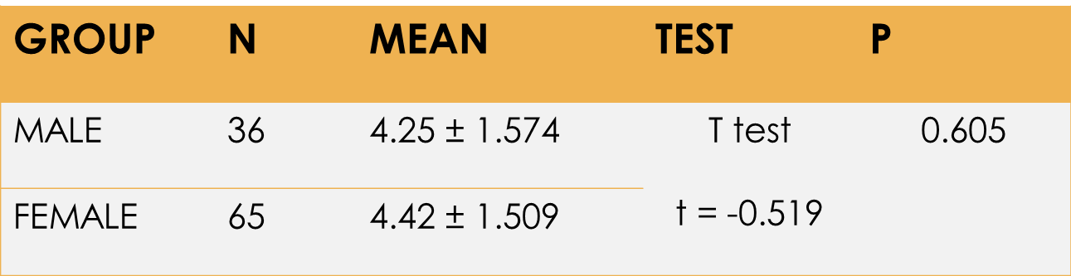
GENDER AND HEALTH LITERACY LEVEL
Gender (Qualitative dichotomous) vs Score (Quantitative)
  Student T-test
  Ho = There is no association between gender and NVS score (health literacy)
Conclusion : Since P=0.605 (>0.05), null hypothesis is not rejected.
There is no association between gender and score.

Slide 18
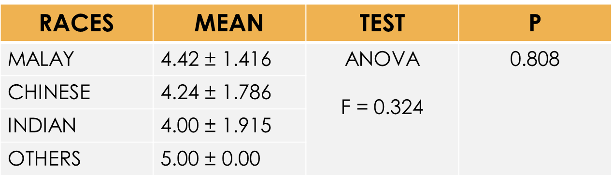
RACE AND HEALTH LITERACY LEVEL
Race (Qualitative Polynomial) vs Score (Quantitative)
  One Way ANOVA
  Ho : There is no association between race and health literacy level.
Conclusion : Since p=0.808 (>0.05), null hypothesis is not rejected.
There is no significant association between race and health literacy.

Slide 19
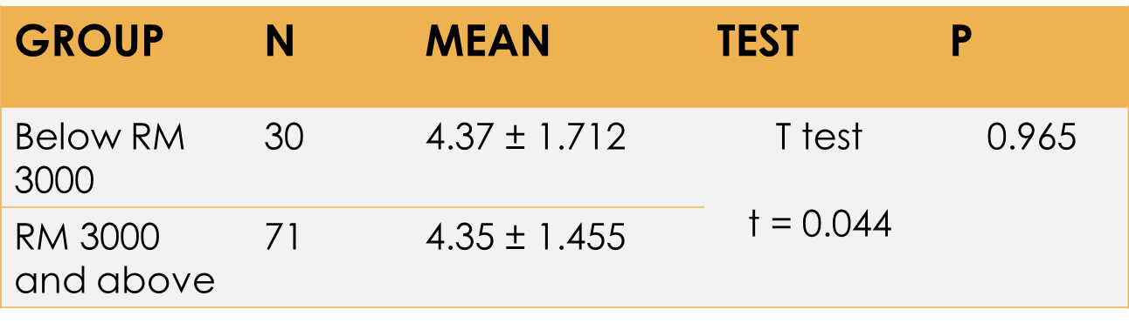
PARENT’S INCOME AND HEALTH LITERACY
PARENT’S INCOME (Qualitative) vs NVS SCORE (Quantitative)
  Student T-test
  Ho : There is no association between income and health literacy.
Conclusion : Since P=0.965 (>0.05), null hypothesis is not rejected.
There is no significant association between income and health literacy.

Slide 20
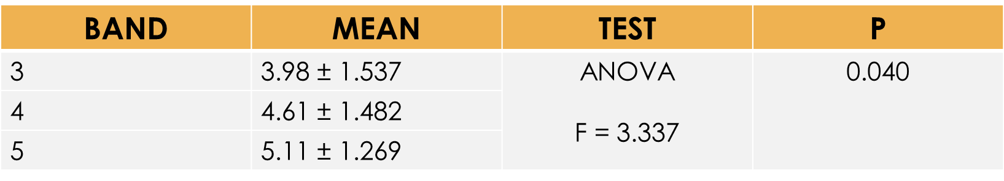
MUET BAND AND HEALTH LITERACY LEVEL
MUET (Qualitative polynomial) vs Score (Quantitative)
  One Way ANOVA
  Ho : There is no association between MUET and the Health literacy
Conclusion : Since p=0.04 (<0.05), null hypothesis is rejected.
There is a significant association between MUET and health literacy.
The higher the MUET band score, the higher the health literacy level.

Slide 21
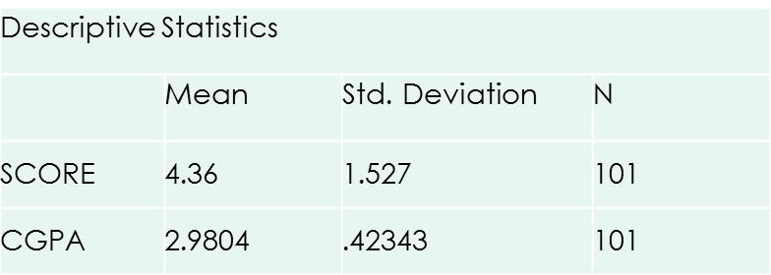
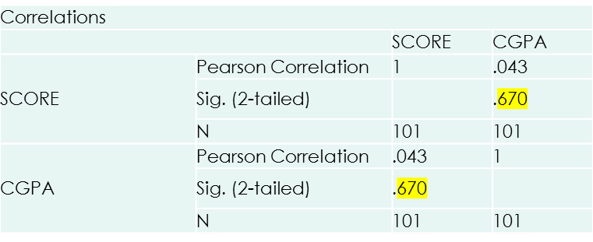
1ST YEAR CGPA AND HEALTH LITERACY LEVEL
CGPA (Quantitative) vs Score (Quantitative)
  Pearson correlation
  Ho : There is no association between CGPA and NVS score (health literacy score).
Conclusion : Since p=0.670 (>0.05), null hypothesis is not rejected.
There is no significant association between CGPA and the health literacy.
The r = 0.043, this indicates a poor and positive linear relationship.

Slide 22
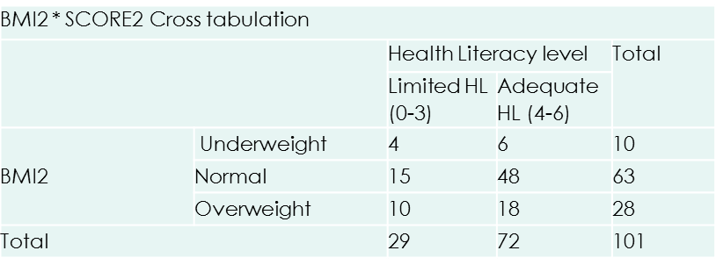
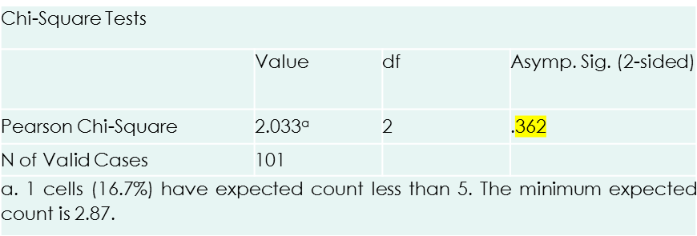
BODY MASS INDEX AND HEALTH LITERACY LEVEL
BMI categories (Qualitative) vs Health Literacy level (Qualitative)
  Chi-Square Test
  Ho : there is no association between BMI and health literacy level
Conclusion : Since P=0.362 (<0.05), null hypothesis is not rejected.
There is no significant association between BMI and the level of health literacy.

Slide 23
DISCUSSION
Only 71.2% of medical students have adequate level of health literacy.
Against the research finding conducted by Journal of Pharmaceutical Health Service Research.
Supposedly all medical students should have adequate level of health literacy.
HEALTH LITERACY
Questionnaires are all in English.
Affect the understanding of students upon questioning.
There is significant association of MUET with the level of health literacy.
MUET
People with higher CGPA not necessarily have higher level of health literacy.
CGPA

Slide 24
STUDY LIMITATION
Sample size
  Research were only doing for a 101 out of 187 second year medical students
  Cannot represent a true picture of the all medical students.
Misinterpretation
  Research was done by interview method. The participants are not allow to see the questionnaire. Thus, there is presence of misinterpretation
Mathematical skill
  Calculators are not allow to be used during interview. Students tend to make a mathematical error even though they understand the question
The research is only for medical students and not for other students from different faculties
  Maybe there will be different opinion and give different result.
Language barrier
  The interview was done mainly in English. The students tend to misunderstood the questions

Slide 25
CONCLUSION
The factor that affect the Health Literacy among second year UKM medical students is :-
    MUET band
Therefore, we as the medical students should enhance our English proficiency in order to get better health literacy.
In addition, doctors are front liner, patient see doctor for nutritional and healthy lifestyle advice. Therefore it is important for doctor to have adequate health literacy to enable them to effectively educate their patients.

Slide 26
RECOMMENDATIONS
In the future, the targeted sample should involve all medical students from first to fifth year.
Increase the sample size that represents the general population.
Provide a multi language question for those who does not fully understand English to avoid misunderstanding.
Allow the respondents to read the questionnaire to avoid misinterpretation.
More health education material should be in multi language.

