Slide 1
PREVALENCE OF OVERWEIGHT AMONG 2ND YEAR MEDICAL STUDENTS AND THE ASSOCIATED FACTORS
LABORATORY 9
FACILITATOR: DR. MOHD FAIRUZ ADDNAN

Slide 2
INTRODUCTION
According to WHO (2015),
Overweight and obesity: Abnormal or excessive fat accumulation that may impair health
Body mass index (BMI): A person’s weight in kilograms divided by the square of his height in meters (kg/m²) and is commonly used to classify overweight and obesity in adults.

Slide 3
PREVALENCE OF OBESITY
In 2014, it was estimated that 39% of adults aged 18 years and over were overweight (WHO 2015)
 | Prevalence of obesity, BMI ≥ 30 (%)
 | 2014 |  |  | 2010
 | Both sexes | Female | Male | Both sexes | Female | Male
South-East Asia | 5 [3.9-6.1] | 6.8 [5.1-9.1] | 3.2 [2.1-4.7] | 4 [3.3-4.7] | 5.6 [4.5-7] | 2.5 [1.8-3.3]
Global | 12.9 [12-13.9] | 15.2 [13.8-16.8] | 10.7 [9.4-12] | 11.5 [10.8-12.1] | 13.7 [12.7-14.7] | 9.3 [8.5-10.2]
Table: Prevalence of obesity in different region (WHO 2014)
According to a study research done by British Medical Journal, The Lancet in 2013, obesity rate in Malaysia is the highest followed by South Korea (33.2%) and China (28,3%).
In 2014, Malaysia has the highest rates of obesity in South-East Asia and the sixth in Asia-Pacific Region [The Star 2014].

Slide 4
PROBLEM STATEMENT
The prevalence of overweight has been widely reported in Malaysia.
Overweight is a major risk factor for non-communicable diseases such as cardiovascular diseases, diabetes, musculoskeletal disorders and cancers.
As a medical student, it is important to practise healthy lifestyle because you are going to become a doctor or general practitioner (GP) that will serve as health role models.
Therefore, it is important to measure the level of prevalence of overweight among medical students in Universiti Kebangsaan Malaysia (UKM) and examine the associated factors such as gender, family history, ethnicity, physical activity and diet.

Slide 5
OBJECTIVES
GENERAL | To determine the prevalence of overweight among 2nd year medical students and associated factors.
SPECIFIC | To determine the prevalence of overweight. To study the relationship between non-modifiable factors such as gender, family history and ethnicity with overweight. To determine the relationship between physical activity and overweight. To investigate the relationship between fast food consumption and overweight.

Slide 6
HYPOTHESIS
Prevalence of overweight/obesity in female is higher compared to male.
Prevalence of overweight/obesity is higher among Malay compared to non-Malay.
Prevalence of overweight/obesity is higher in those who are physically inactive than in those who are physically active.
Prevalence of overweight/obesity is higher in those who has high consumption of fast food compared to those who has low consumption of fast food.

Slide 7
CONCEPTUAL FRAMEWORK
FACTORS
OUTCOME
OVERWEIGHT
MODIFIABLE
Physical activity
Dietary
NON-MODIFIABLE
*Genetics
Gender
Ethnicity

Slide 8
SIGNIFICANCE
THEORETICAL IMPLICATION
The study determined the enable factors associated with prevalence of overweight among medical students. The relationship between overweight and associated factors could be explained in more details. This will help students to differentiate between modifiable and non modifiable factors.
PRACTICAL IMPLICATION
This study is important for overweight students as it able to create awareness about the factors that contribute to overweight.
This study also enables the doctors and government to develop programs that effectively increase the awareness among community about overweight.
This research also enables doctors and specialists to give good advices on ways to prevent overweight.

Slide 9
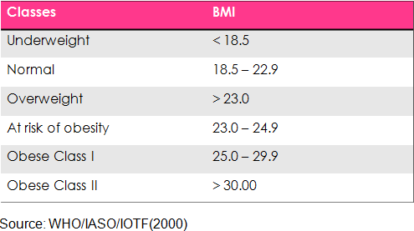
Classification Of BMI

Slide 10
LITERATURE REVIEW
Gender
“In developed countries, more men are overweight than women” (Rebecca Kanter, 2012)
Sources : Global Gender Disparities in Obesity: A Review. American Society for Nutrition. Adv. Nutr. 3: 491–498.

Slide 11
LITERATURE REVIEW
Ethnic
“The highest prevalence of both overweight subjects were among the Indians (24.6%), followed by Malays (23.2%) and the lowest prevalence was among the Chinese (8.2%)” (Wan Nazaimoon Wan Mahamud et.al 2011)
Sources: Prevalence of overweight and obesity among adult Malaysians: An Update. Pg 35-37

Slide 12
LITERATURE REVIEW
Physical Inactivity
“Overweight prevalence is high in adolescents who are engaging in high levels of inactivity and low levels of moderate to vigorous physical activity”. (Dr. Penny Gordon-Larsen, Linda S. Adair and Barry M. Popkin, 2012)
Sources: Ethnic Difference in Physical Activity and Inactivity Patterns and Overweight Status

Slide 13
LITERATURE REVIEW
Fast Food Consumption
“72.5% of the overweight or obese students consumed fast food at least 4 times/week, and the other 15.9% were taking fast food 1- 3 times/week, while only 11.6% of the same overweight or obese group did not consume any fast food/ week” (Monira AR, Mohammed Alsaif, Muslim A, A. Ali)
Sources: Fast food intake and prevalence of obesity in school children in Riyadh City. Sudanese Journal of Paediatrics 2014

Slide 14
METHODOLOGY
A) CROSS-SECTIONAL STUDY
measures the relationships of variables in a defined population at a particular time.
Factors Outcomes
Modifiable:
Physical activity
Fast food consumption
Body mass index (BMI)
Non-modifiable:
- Genetics
Ethnicity
Gender

Slide 15
B) STUDY FIELD
UKMMC
C) CONVENIENT SAMPLING
109 second year medical students of UKM
D) QUESTIONNAIRE
Anthropometric measurement
Socio-demographic
Physical activity (adapted from International Physical Activity Questionnaire, IPAQ)
Fast food consumption (UMP)

Slide 16
E) OPERATIONAL DEFINITIONS
1) Gender
a. Male
b. Female
2) Ethnicity
a. Malay
b. Chinese
c. Indian
d. Others

Slide 17
3) Physical Inactivity
Active: Who do vigorous exercise at least 2 days for 20 minutes per week OR those who moderate exercise at least 5 days for 20 minutes per week.
Inactive: Who do exercise less than 2 times per week.
4) Fast food composition
High: Consume at least 3x per week
Low: Consume less than 3x per week
5) Body mass index (BMI) – based on WHO Asian
a) Underweight / Normal: < 22.9
b) Overweight / Obese: > 23

Slide 18
F) DATA ANALYSIS
SPSS version 17.0
IPAQ
T-Test
Pearson χ²
Yate’s continuity correction

Slide 19
Data analysis

Slide 20
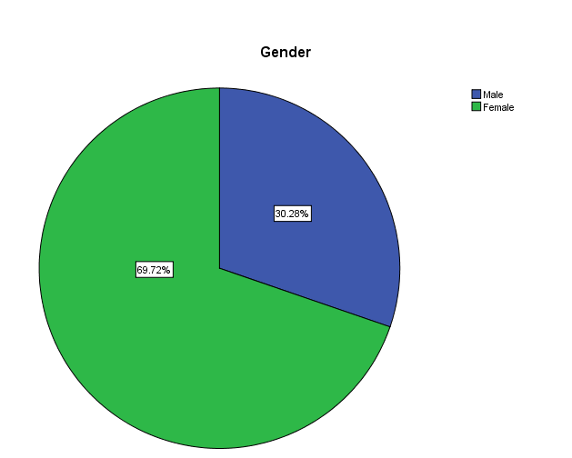
Respondent : Gender
Total male: 33 persons
Total female: 76 persons

Slide 21
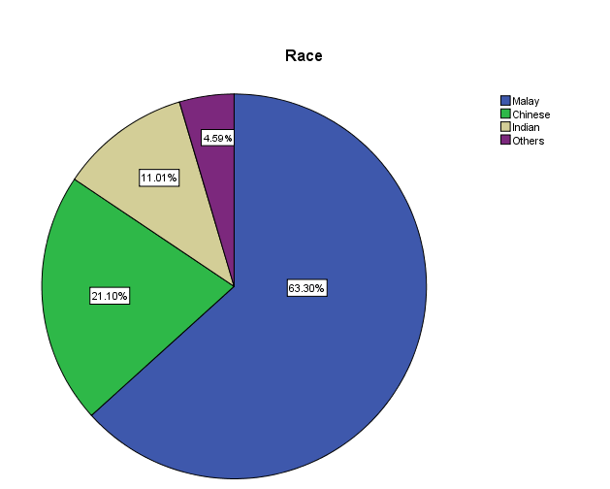
Respondent : Race
Total respondents : 109
Consists of
  Malay: 69 persons
  Chinese : 23 persons
  Indian: 12 persons
  Others: 5 persons

Slide 22
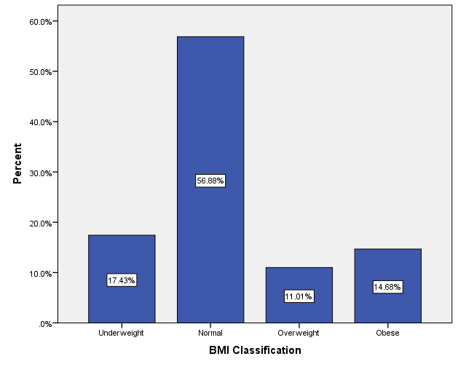
BMI Distribution according to Classification of BMI

Slide 23
T-test

Slide 24
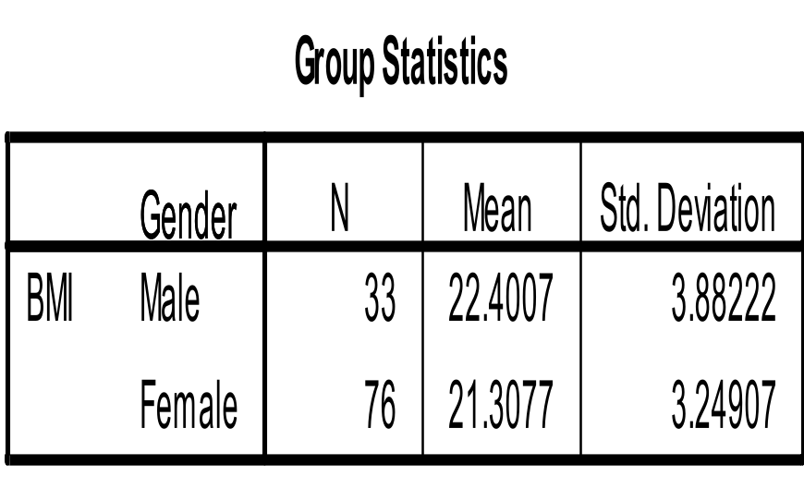
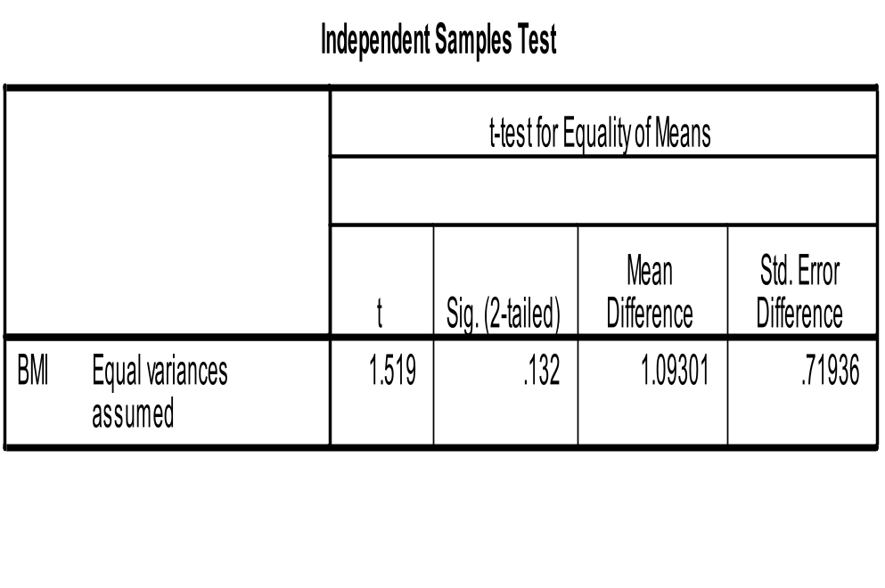
Ho :There is no difference of BMI between Male and Female
P >0.05 –not significant
Ho not rejected
CONCLUSION:
THERE IS NO SIGNIFICANT DIFFERENCE OF MEAN BMI BETWEEN MALE AND FEMALE

Slide 25
CHI-SQUARE TEST

Slide 26
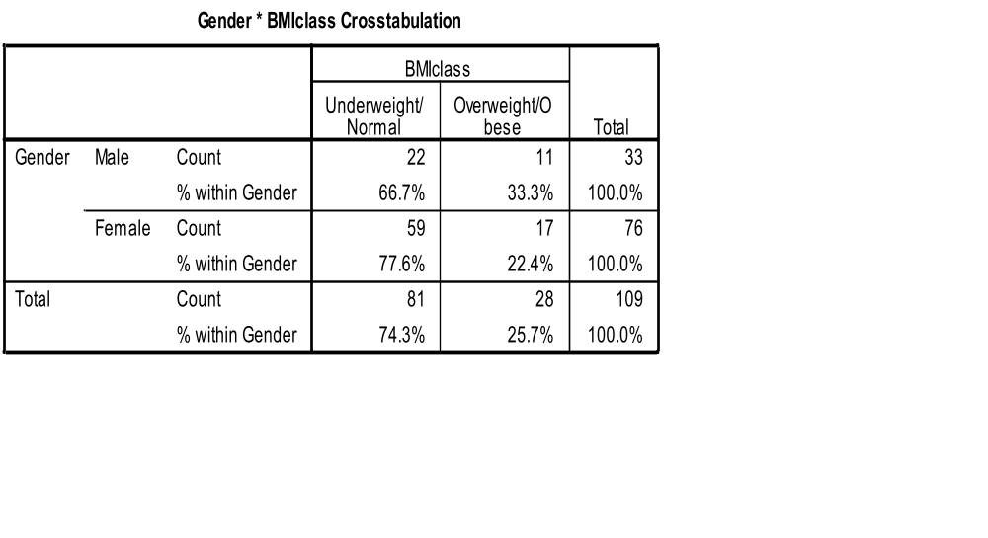
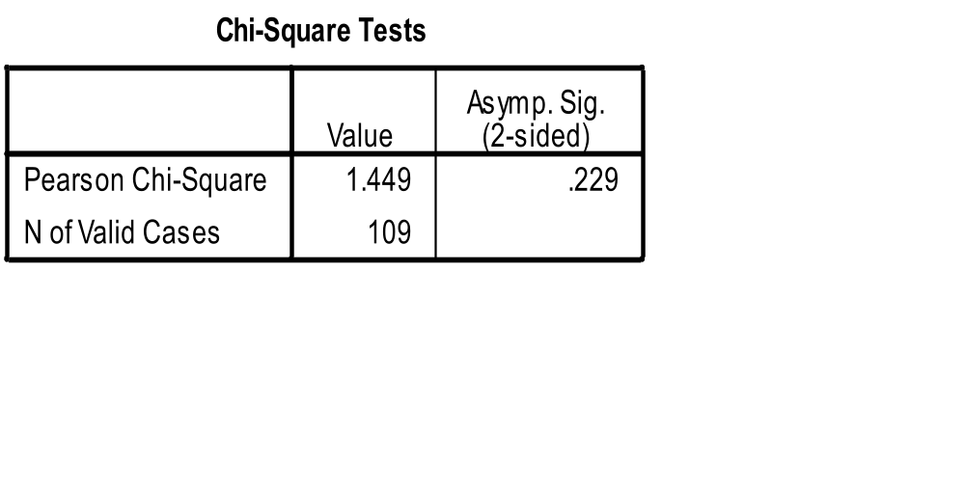
Ho :There is no association between gender, with Body Mass Index (BMI)
P >0.05 –not significant
Ho not rejected
CONCLUSION:
THERE IS NO ASSOCIATION BETWEEN GENDER AND BMI CLASSIFICATION

Slide 27
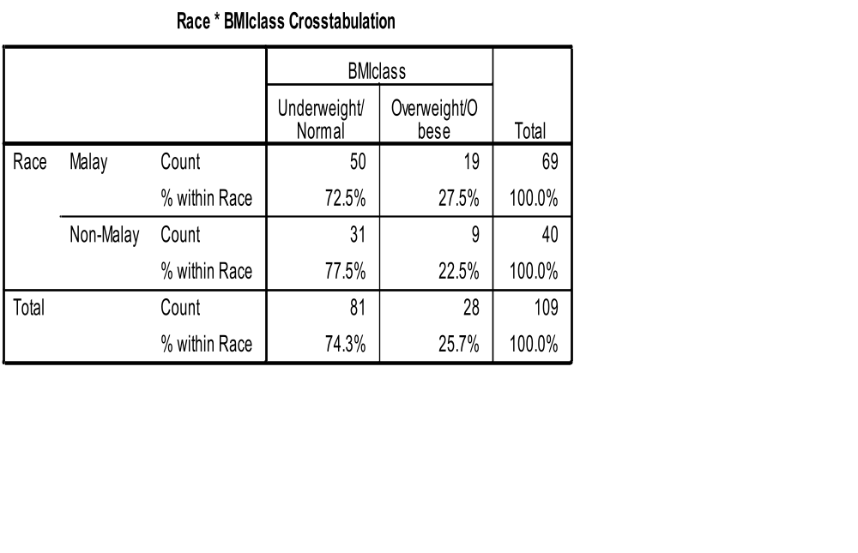
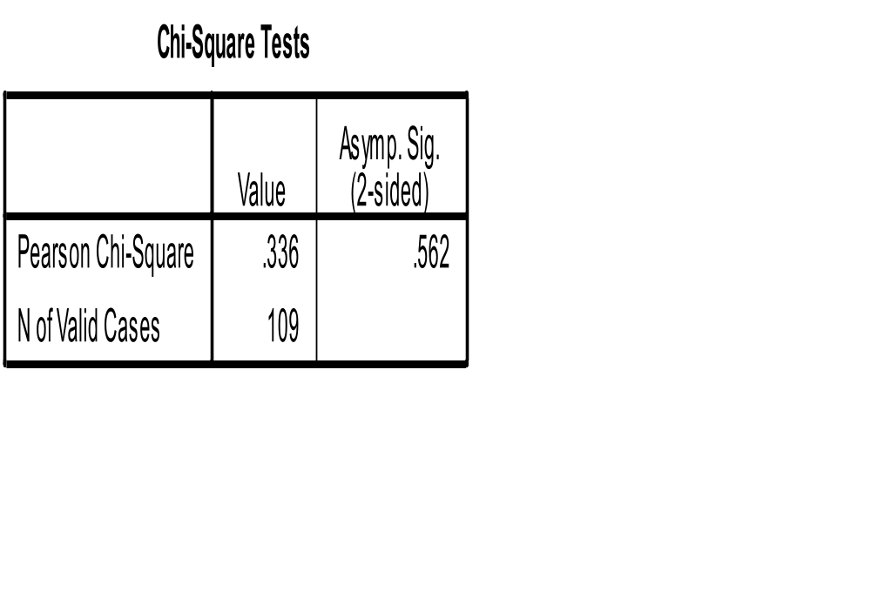
Ho :There is no association between races, with Body Mass Index (BMI)
P >0.05 –not significant
Ho not rejected
CONCLUSION:
THERE IS NO ASSOCIATION BETWEEN RACES AND BMI CLASSIFICATION

Slide 28
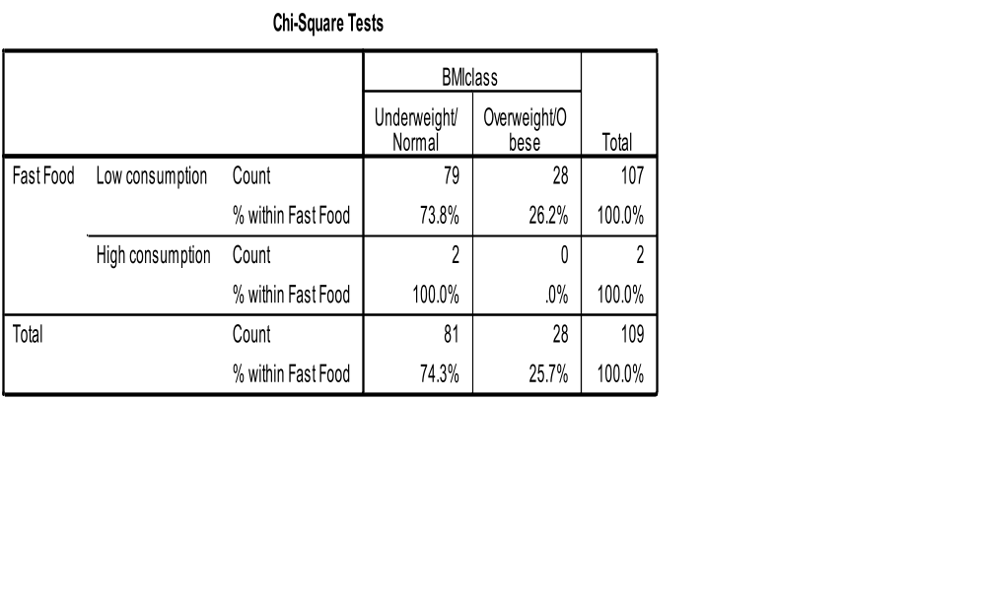
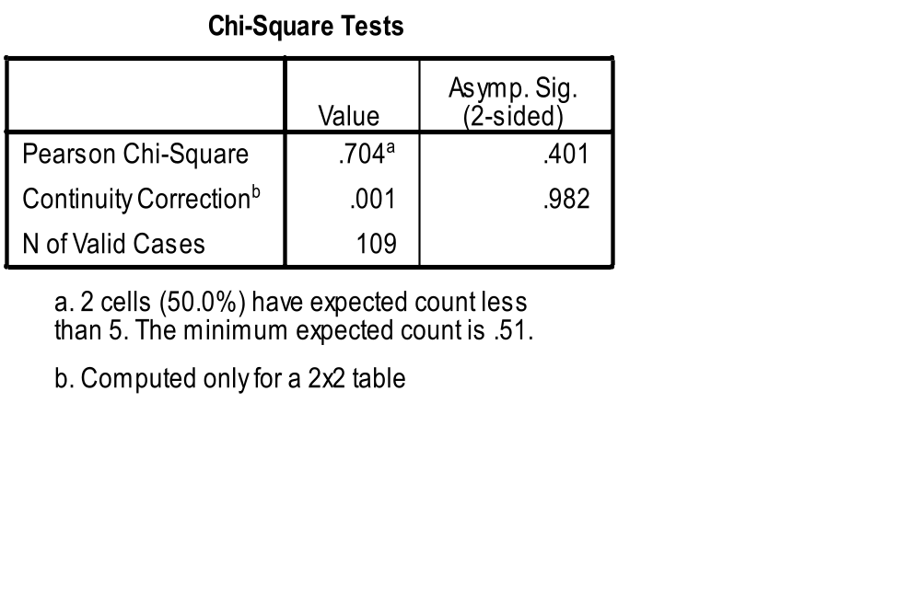
Ho :There is no association between fast food consumption, with Body Mass Index (BMI)
P >0.05 – not significant
Ho not rejected
CONCLUSION:
THERE IS NO SIGNIFICANT ASSOCIATION BETWEEN FOOD CONSUMPTION AND BMI

Slide 29
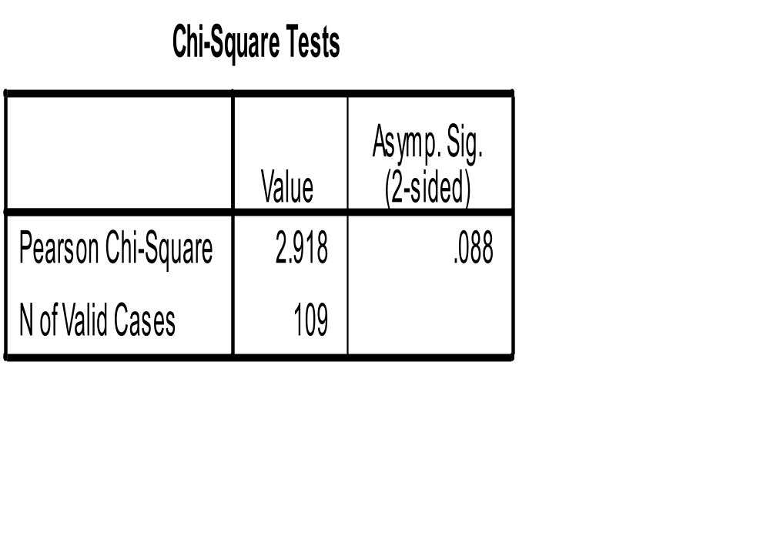
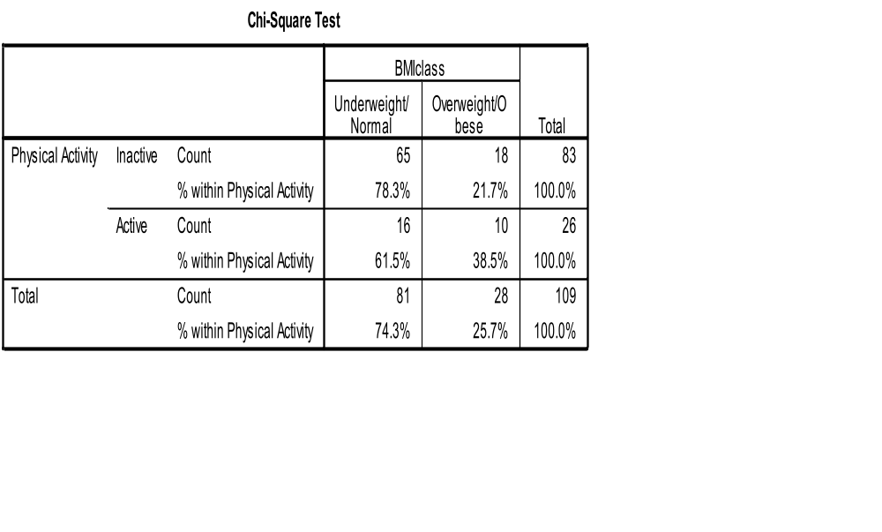
Ho :There is no association between physical activity, with Body Mass Index (BMI)
P >0.05 – not significant
Ho not rejected
CONCLUSION:
THERE IS NO SIGNIFICANT ASSOCIATION BETWEEN PHYSICAL ACTIVITY AND BMI

Slide 30
LIMITATIONS OF RESEARCH
Respondents are composed of 2nd year medical students of UKMMC only.
Sample size is only limited approximately to 109 samples only.
Weight and height measurement are obtained from respondents by their own measurement.
Diet consumption of respondents are only limited to several fast food items included in the questionnaire.
BMI was calculated from the obtained weight and height. BMI is also known to be inaccurate in certain cases.

Slide 31
SUGGESTIONS FOR FUTURE RESEARCH
To include year 1 to year 5 medical students of UKMMC as well as medical students from other University
To increase the sample size of the respondents
To use direct method to obtain exact weight and height of the respondents
Provide food frequency questionnaire to collect more precise data regarding the amount and frequency of food intake
Include waist to hip ratio to support the BMI measurement

Slide 32
That’s All folks ☺
Thank you ^.^

