Slide 1
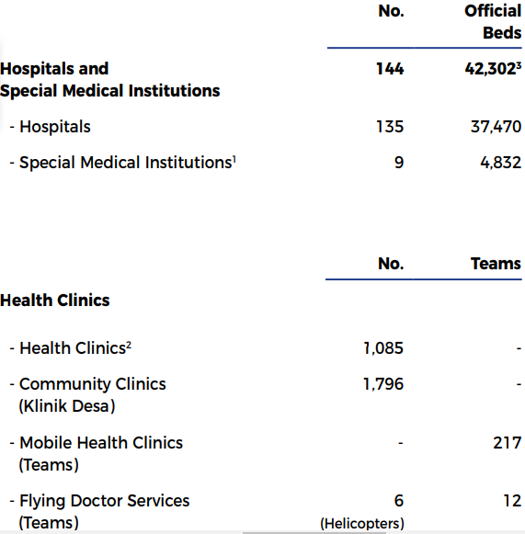
MOH
Health
District Health Office
Public Health Clinics
Hospital
Clinical Departments
Inspectorate
Community Clinics
More Health Facilities than Hospitals

Slide 2
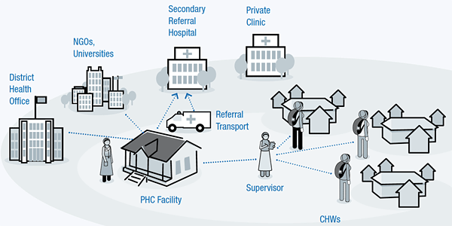
2-Tier System
PHN Sister
Health Centre
Klinik
Komuniti

Slide 3
FF2613
Start with Epidemiology then Medical Statistics
Cont. Marks – 10% minitest epid, 10% minitest stats, 10% online quizzes and 10% research project.
Final – 30 OBA, 30 EMI & 2 MEQ (60%)
Every year 2 must join this FB group https://www.facebook.com/groups/teamstats/
http://drtamil.me/ffff2613/ - notes & quizzes.

Slide 4
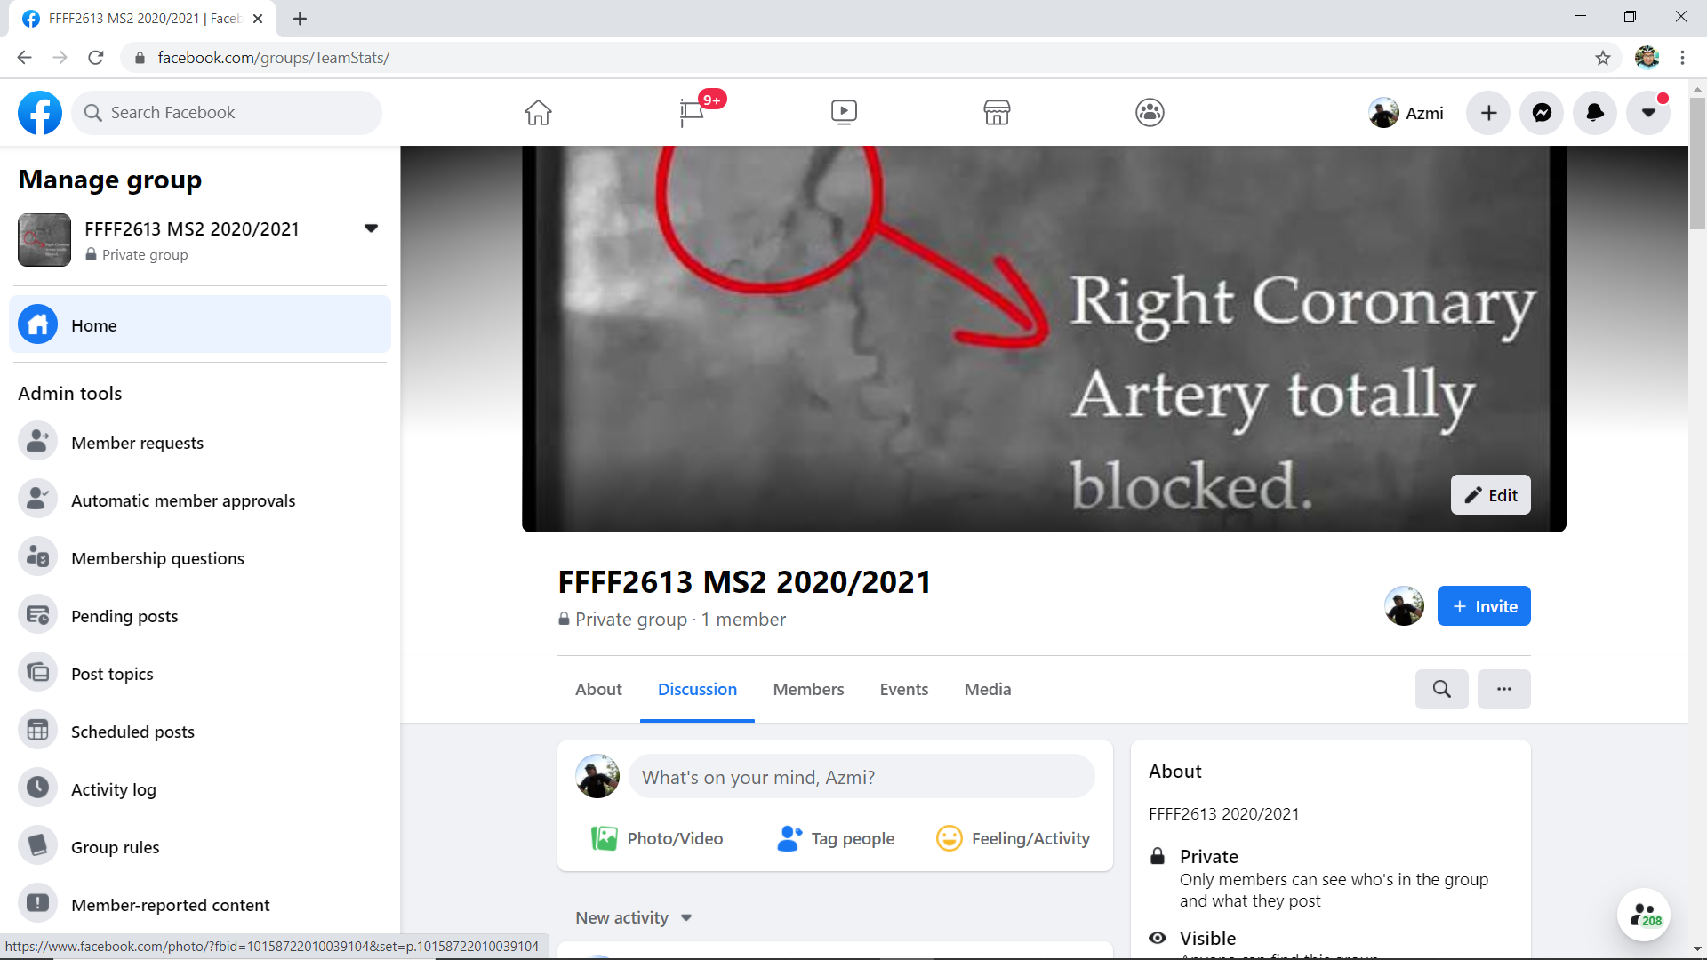
https://www.facebook.com/groups/TeamStats/

Slide 5
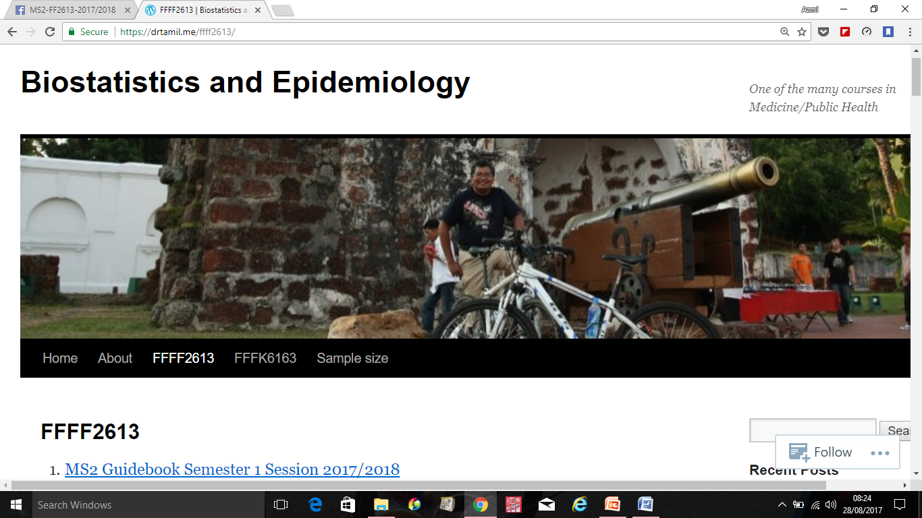
https://drtamil.me/ffff2613/
Download Latest Guidebook

Slide 6
METHODS OF ASSESSMENT
1. Continuous assessment (40%)
Mini Test I (20 MCQ-OBA questions) – 10%
Mini Test II (20 MCQ-OBA questions) – 10%
Research Project Presentation and Written Report – 5% + 5%
Online practical sessions via Google Forms – 10%
2. End of Semester Examination (60%)
30 MCQ-OBA Questions
6 Extended Matching Item Questions (Each theme contain 5 item stems)
2 Modified Essay Questions

Slide 7
Research Project Video
Using software such as Camtasia Studio, students record their 10 minutes presentation and submit it to YouTube prior to the scheduled sessions.
https://drive.google.com/file/d/0B1QufWE4ybURdWlrREl5WE4yb3c/view?usp=sharing
https://ppukm.org/2014/06/03/e-learning-installing-camtasia-studio-8/
https://ppukm.org/2016/03/05/sharing-videos-on-the-ifolio/

